Slide 1


REMID VIS
Mašinski centar - Remid Vis d.o.o.

Slide 2

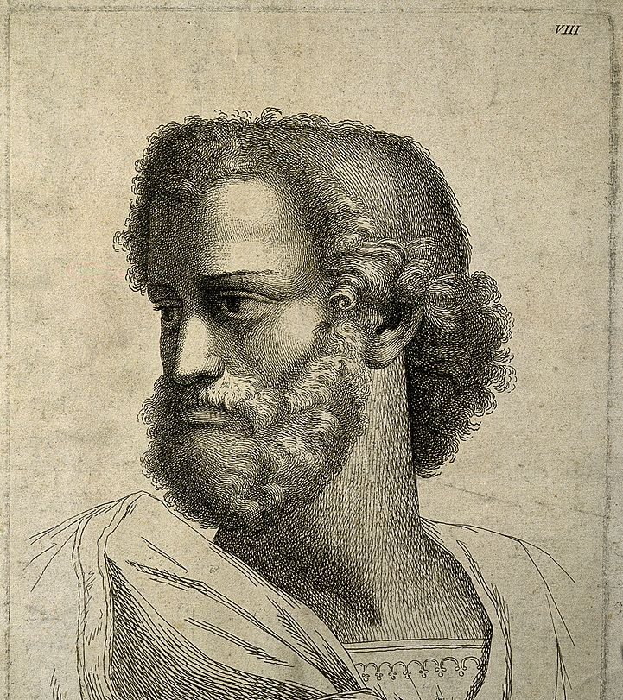

„Quality is not act. It is a habit“
What we care about:

Slide 3

ABOUT US
Remid Vis Mechanical Engineering Center is a company dedicated to making life easier.
Founded in the year 1998, the company’s motto has always been “perfection in motion”.
Our mission is just that; to help maintain that movement at a practical level, through the production of parts that actually work!
3500 B.C.
Creation of the wheel
50 A.D.
Creation of gears and cogwheels
1760
Industrial Revolution
1998
Beginning ideas of Remid Vis – Mechanical Engineering Center
2002
Establishment of Remid Vis – Mechanical Engineering Center
2023
Remid Vis helping you keep up!

Slide 4




WHAT WE DO:
Our two main business concepts are:
Service and technical center (where we repair) and
Production center (where we create)

Slide 5

Our company can best be described with the words of the Greek philosopher Heraclitus “Panta rhei” – everything flows. Life continues in perpetual motion, Remid Vis can help you keep up by providing a number of products and services.

Slide 6

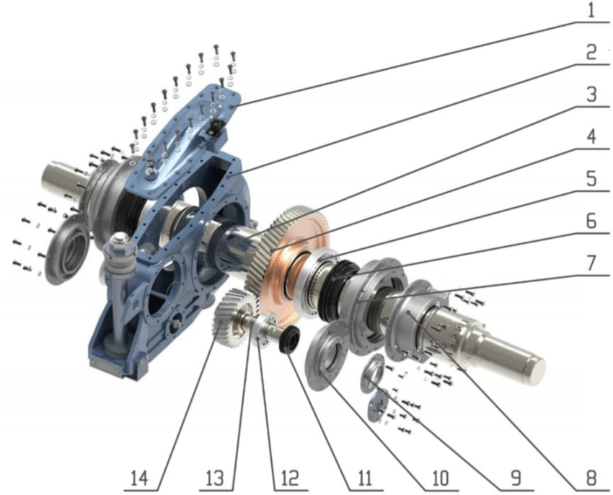
Service and technical center (where we repair)

Slide 7
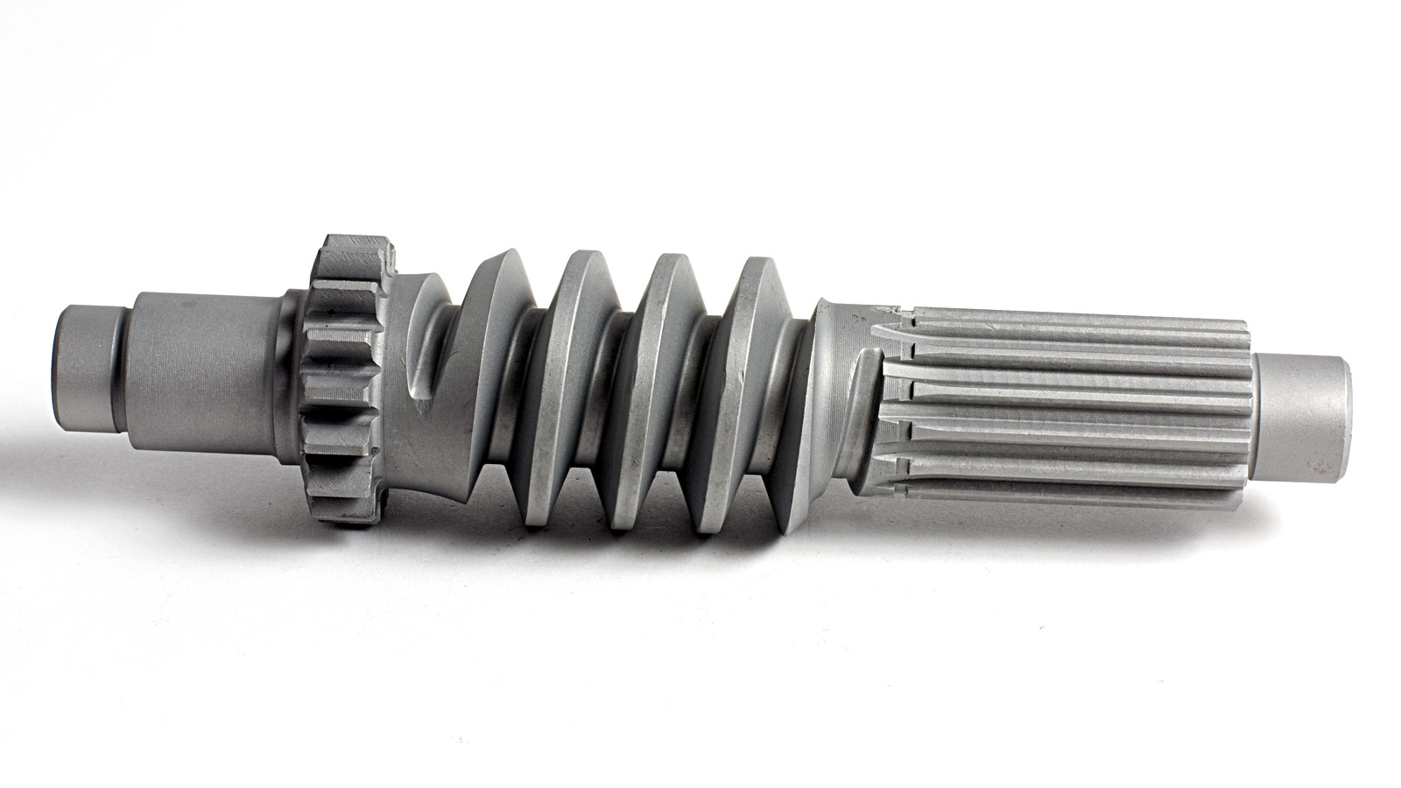
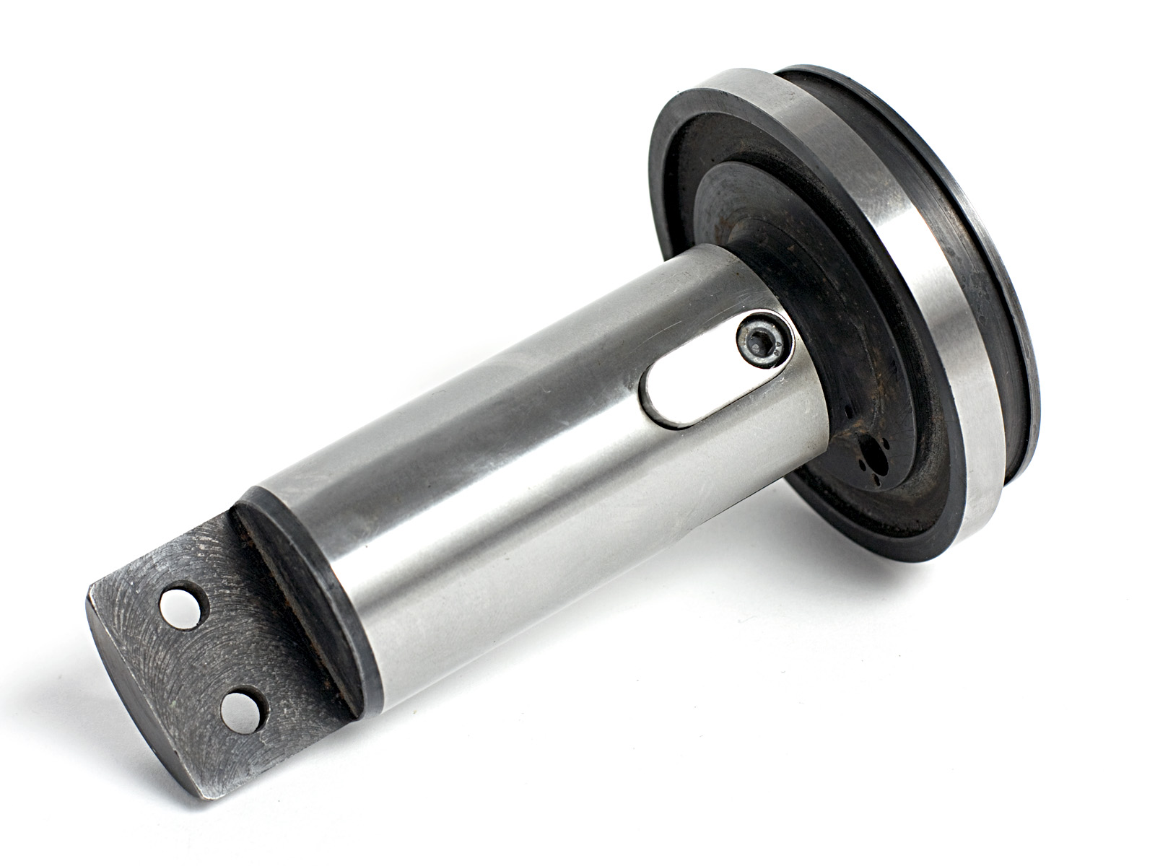
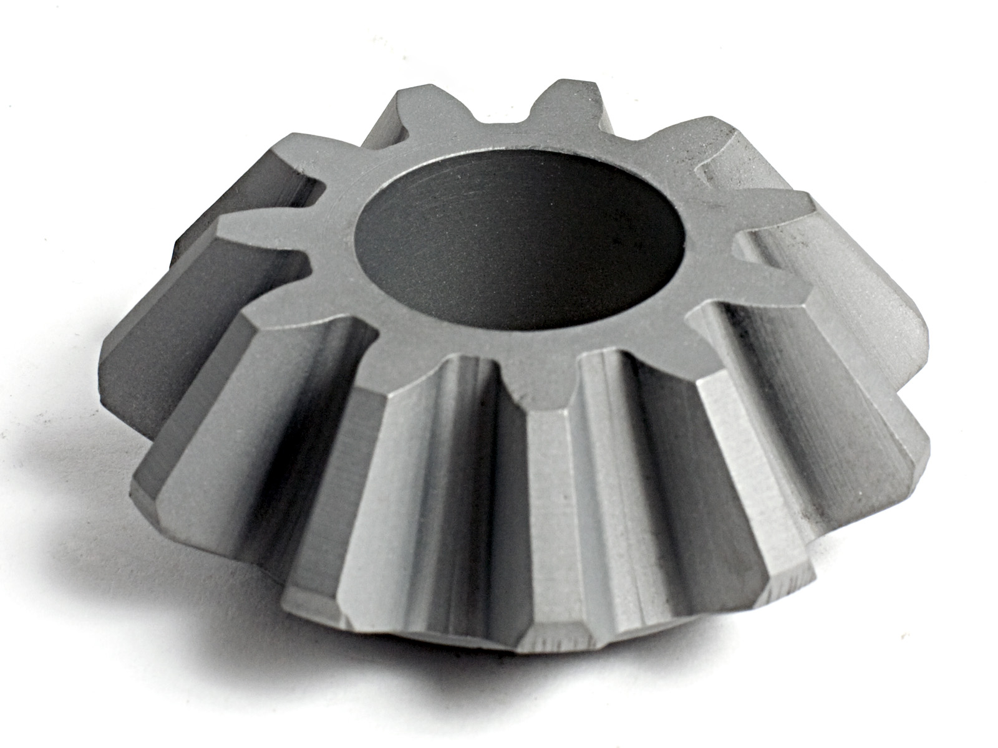
Production center (where we create)

Slide 8
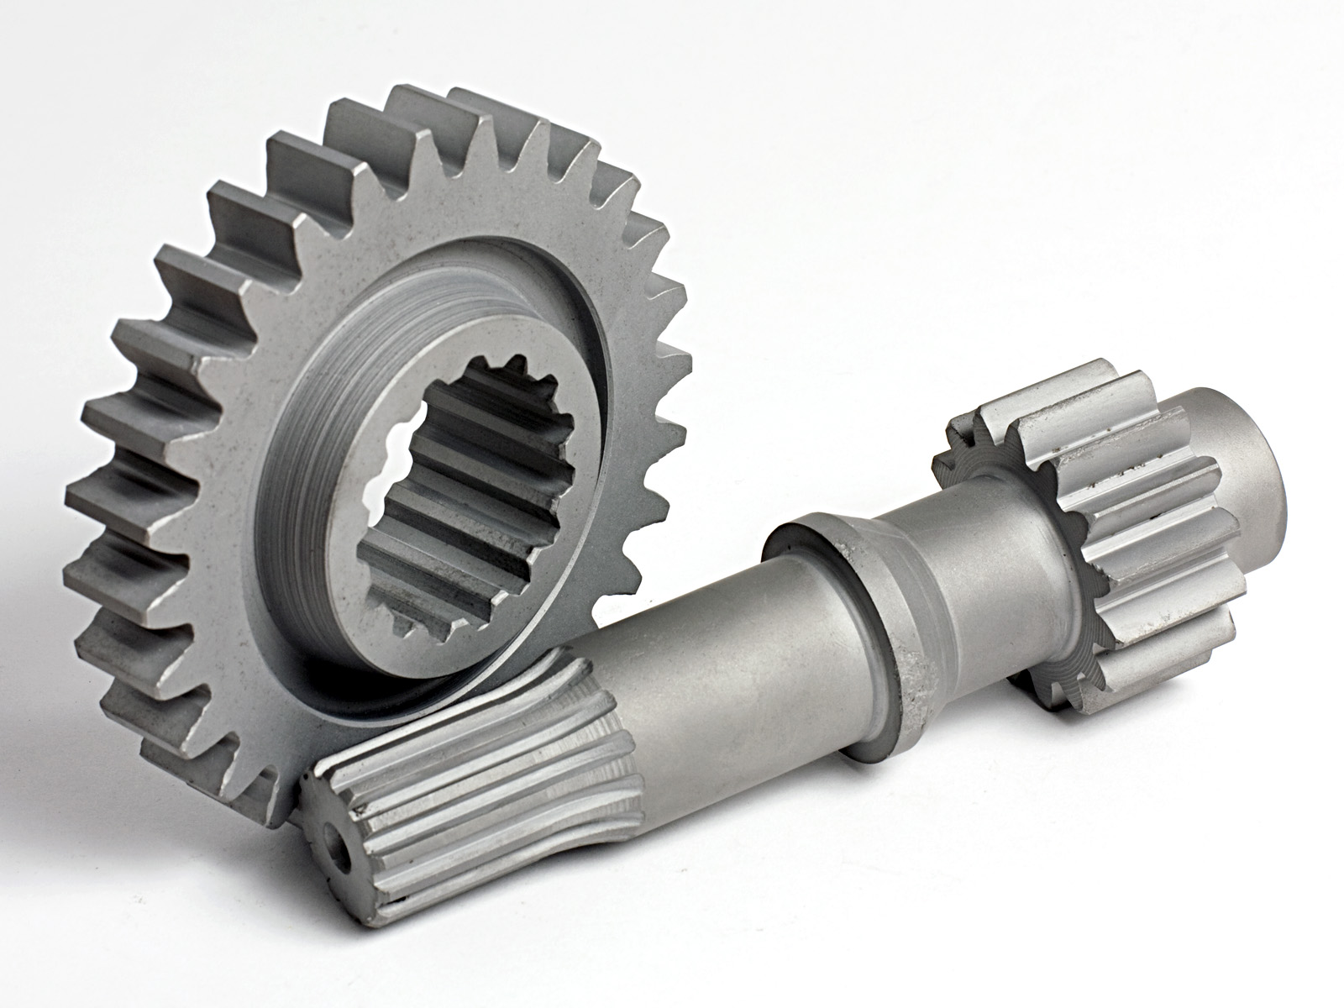
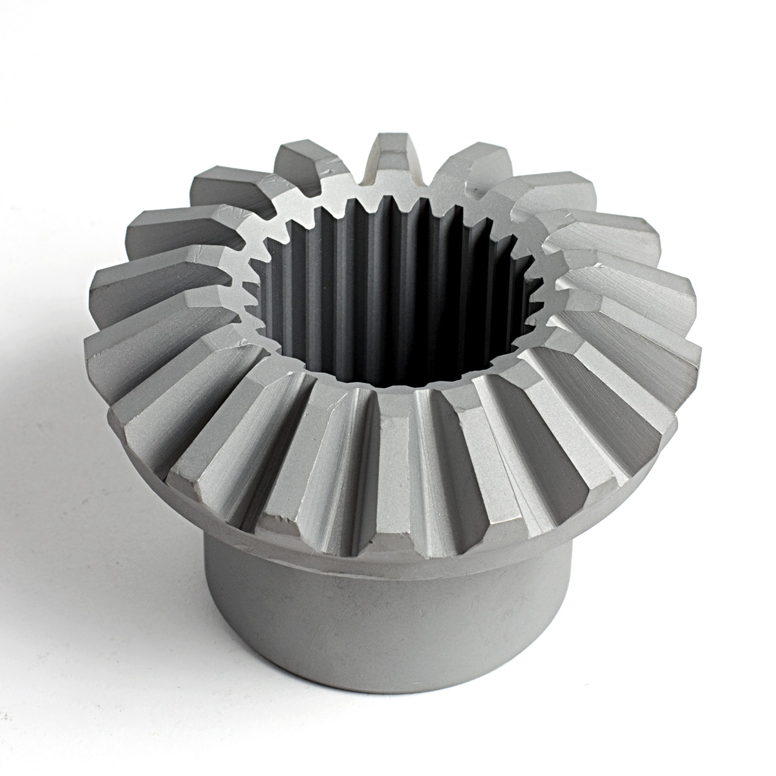
Production center (where we create)

Slide 9
Our products:
Cylindrical gear wheel
Rack
Straight bevel gears
Spiral bevel gears
Worm drive
Toothed shaft
Grooved shafts
Toothed gear segments
Sprockets
(Materials: improved steel, cemented steel, bronze metal, plastic, polyamide)

Slide 10
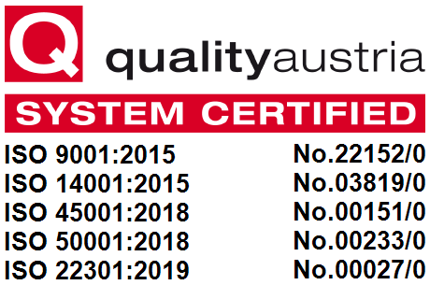
ISO 9001:2015 Quality management systems
ISO 14001:2015 Environmental management systems
ISO 45001:2018 Occupational Health and Safety
ISO 50001:2018 Energy management systems
ISO 22301:2019 Security and resilience — Business continuity.

Slide 11
Thank you for your attention !

