Slide 1
MEDENA COMMERCE
„We strongly support your business“

Slide 2
Who we are?
Family company, established 1995.
Offer services from turning up to milling
As well as weldig and assembling
Today 68 employees
Turnover in 2022 EUR 3,16 mil.
Certified according to ISO 9001, ISO 14001, EN 1090 and EN 3834-2

Slide 4
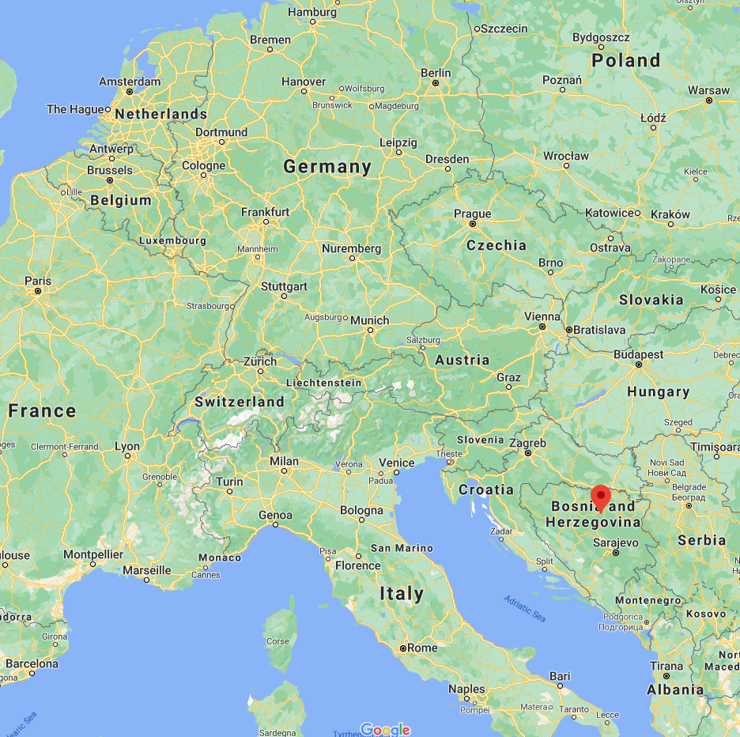
Where we are?
Tešanj, BA
150 km from Sarajevo
280 km from Zagreb
800 km from Munich
1020 km from Stuttgart
1360 km from Duesseldorf
1500 km from Hamburg

Slide 5
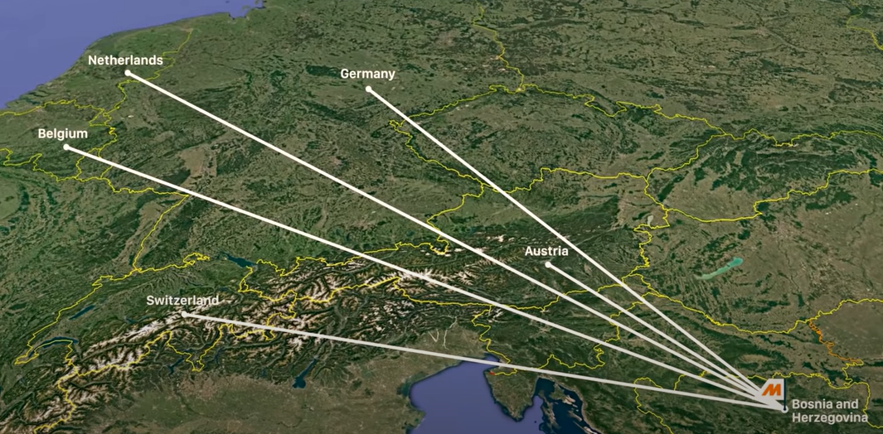
Whose are our customers?
Automatisation
Automotive/ conveyor systems
Machine building
Germany
Netherlands
Switzerland
Denmark

Slide 6
Milling capabilities
Up to 4000x2000x1200mm
8 CNC milling machines old from 10 to 4 year
One 5-axes, one 5 side
One vertical with 4 axes
Two horizontal centers
Three 3-axes vertical centers
Materials: steel, stainless steel, aluminum and plastic

Slide 7
Turning capabilities
Up to fi 350x500mm with CNC lathes
Up to fi 900x2000 on classic lathes
3 CNC lathes
3 classic lathe machines
Materials: steel, stainless steel, aluminum and plastic

Slide 8
Welding and assembling
Six certified welders according to EN 287-1
MIG/MAG and TIG welding processes
Welding tools and desks up to 2000x4000mm
Assembling parts produced at our facility with buying parts and parts delivered from customer
7 experienced assemblers for mechanical and electrical assembling

Slide 9
Outsourcing and Logistic
Outsourced services:
Laser cutting
Surface treatment
Hardening
Logistic
Own transport up to 1,5t
Spedition transport over 1,5t

Slide 10
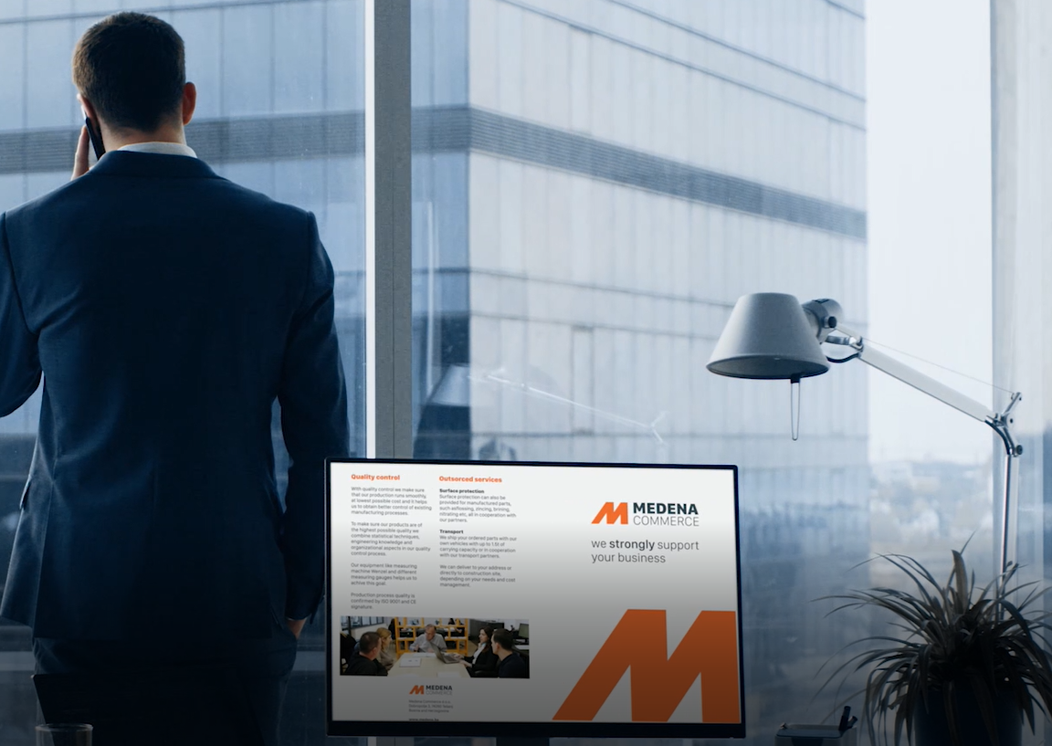
THANK YOU FOR YOUR ATTENTION!

