Slide 2
Who are we?

Slide 3
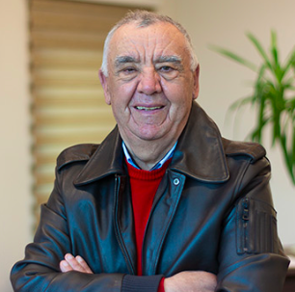
A word from our owner:
“I have started this business in 1987 year as a small retail shop in Prilep, N.Macedonia. I have chosen this business because the products we work with are standard and they are used all over the world. We started as team of 3 people.
In 1993 we opened the offices in capital city Skopje,
In 2002 where we started a production business on our own.
In 2015 we moved to our newly build factory and today we are team of 60 people.
I am proud we are proven leader in the region and we continue with our innovation to stay on the top and face all the challenges in today’s world.”
- Aleksandar Zdraveski

Slide 4
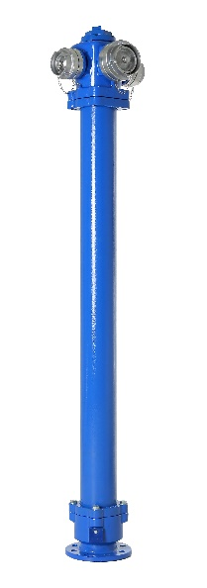
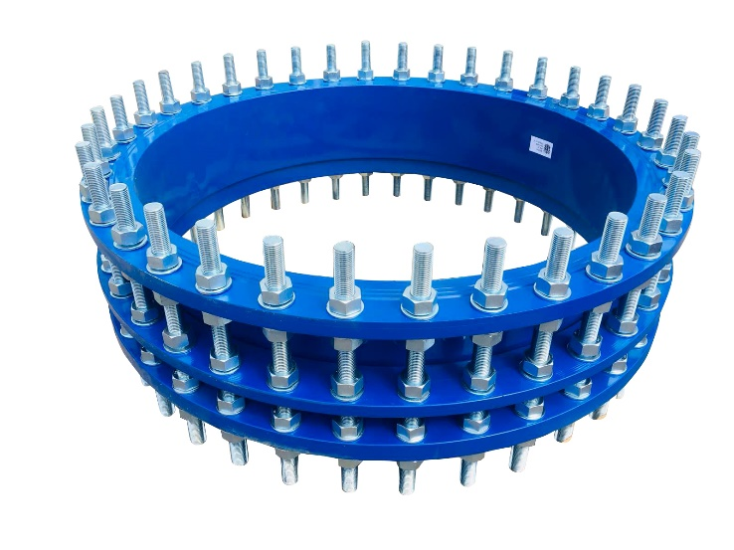
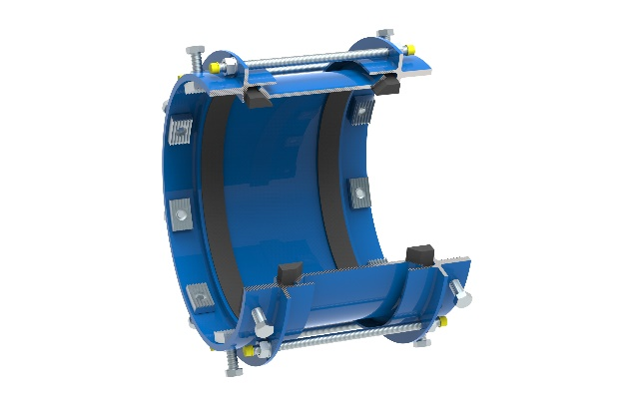
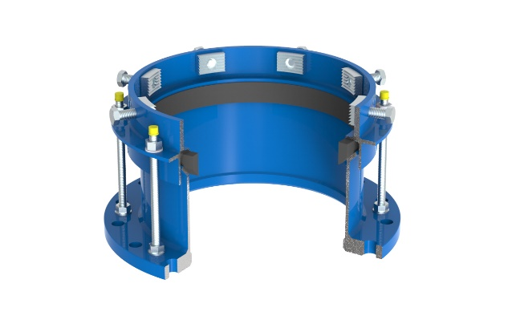
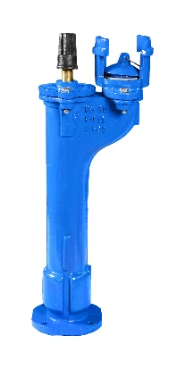
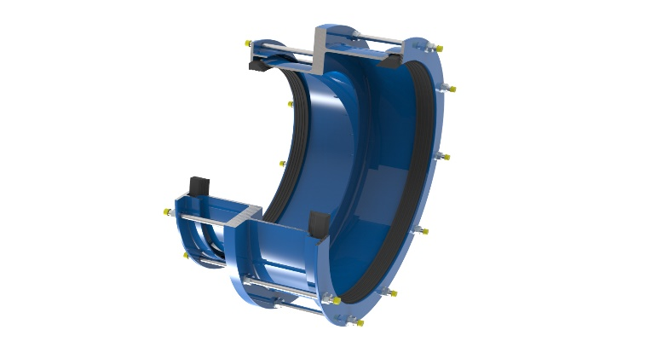
We are second generation family owned company which traces its origin back in 1987. Our business is manufacturing and sale of a whole range of plumbing elements such as dismantling joints, valves and hydrants, ductile iron and steel pipes fittings, and other individually designed products.
OUR TOP PRODUCTS:
DISMANTLING JOINT
CONNECTING ELEMENTS
HYDRANTS

Slide 5
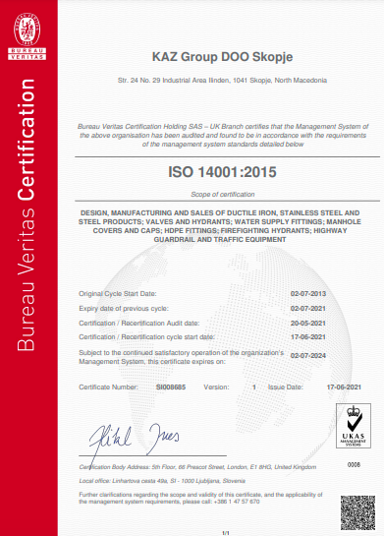
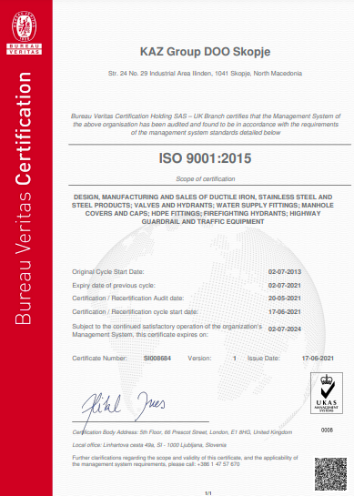
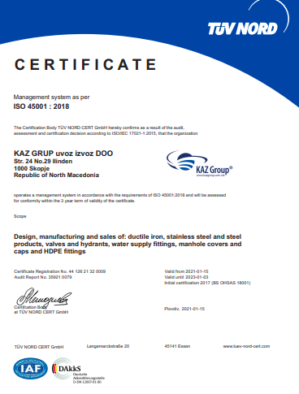
Our production line is in a brand new and modern facility, which is in full compliance with the following global standards: Quality Management (ISO9001:2015), Environmental Management (ISO 14001:2015), and also our company received the prestigious House of Bureau Veritas as well as the OHSAS18001:2017 occupational health and safety assessment series awarded by TUV NORD.

Slide 6
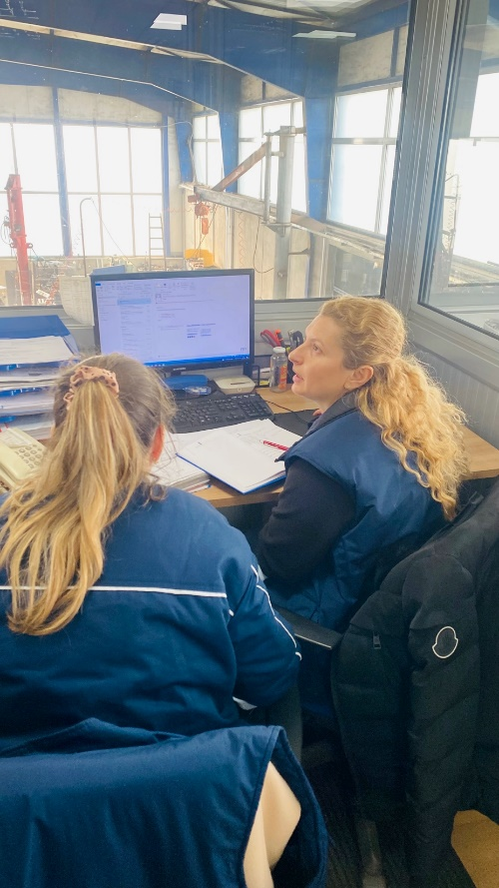
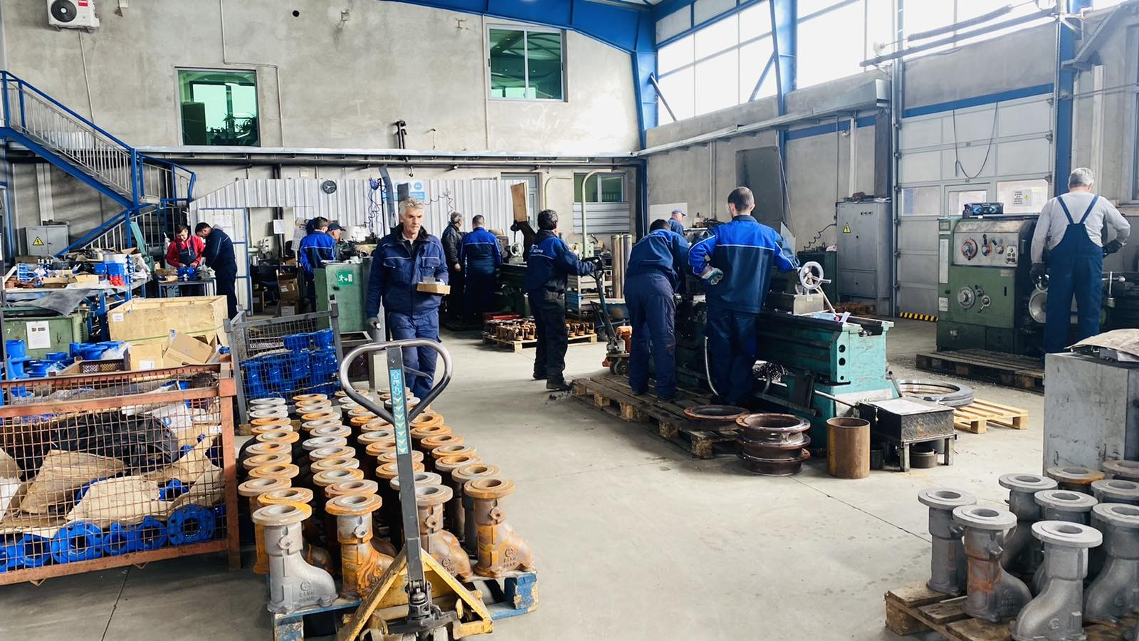
The great expertise of KAZ Group makes it a leading company in its field in Macedonia and the wider region. Our long-standing work on the market is supported by proven quality and product range, as well as a customer-oriented approach to business. We export to more than 12 countries (Oman, Portugal, Germany, Spain, Italy, Ukraine and all Balkan countries) In many of these countries we have loyal customer with which we work for over 20 years.

Slide 8
Our team

Slide 9
