Slide 1
Welcome to
A member of

Slide 2
Contents
Company profile
Products
Machines and equipment
Customers
Future plans

Slide 3
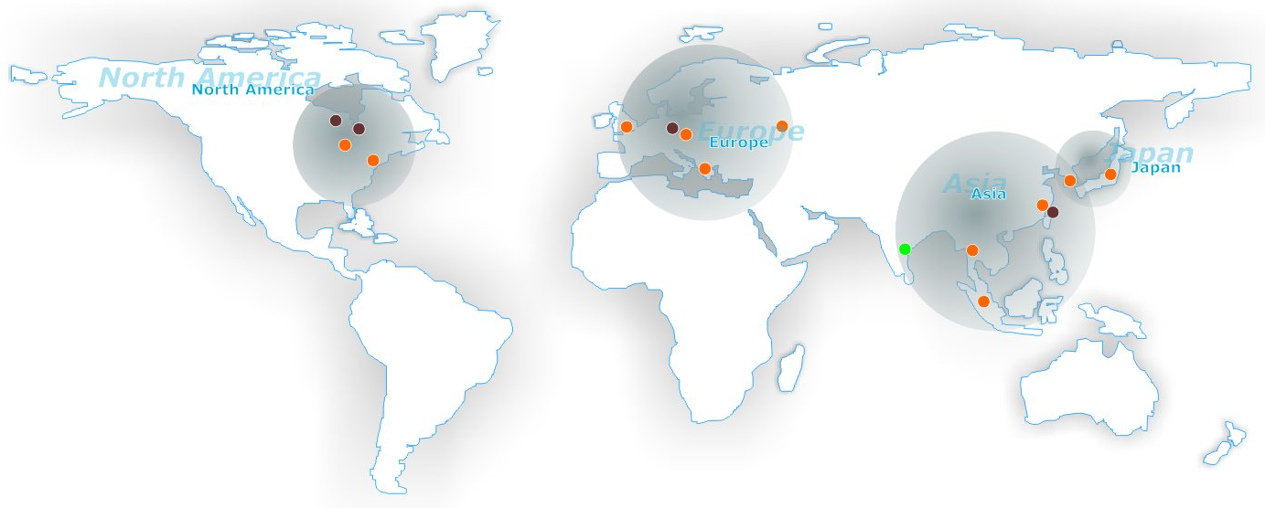
Member of Daido Group

Slide 4
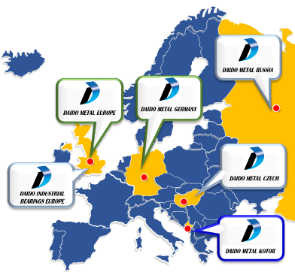
Member of Daido Group
Daido Metal Co.LTD.
(DMJ)
[Japan]
Daido Metal Europe
(DME / DMEG)
DAIDO METAL
KOTOR
(DMK)
DAIDO METAL
CZECH
(DMC)
DAIDO INDUSTRIAL
BEARINGS EUROPE
(DIBE)
DAIDO METAL
RUSSIA
(DMR)
Engine Bearings
Polymer bushings
Engine Bearings
& Small Turbo
Marine, Turbo etc.
Engine Bearings
＆Bimetal

Slide 5
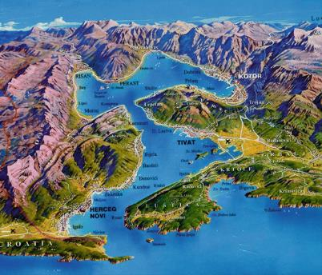
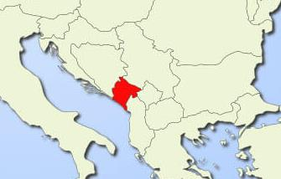
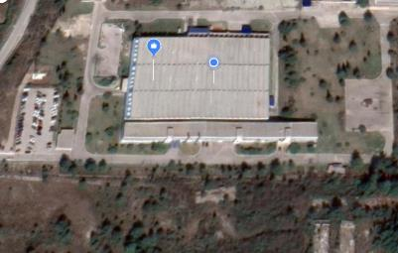
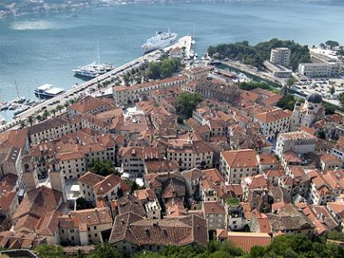
Our location
Kotor
Tivat
KOTOR City
(Old Town)
TIVAT
Porto Montenegro

Slide 6
About us
Land 70,000 m²
Factory 11.500 m²
Offices 2.500 m²
Shares distribution
Administration 7%
Direct 75%
Manufacturing 93%
Indirect 25%
147employees

Slide 7
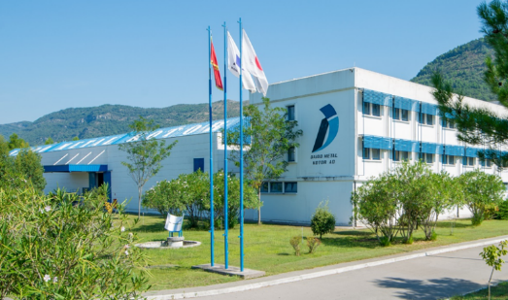
About us
Industrija lezaja Kotor – ILK (Bearing industry Kotor) was established in February 1956.
Mainly produced bearings and bushings,
mostly for aftermarket in Yugoslavia, Egypt, Hungary and Russia.
In February 2002 was sold to Daido Metal Japan and Daido Metal Kotor was established.

Slide 8
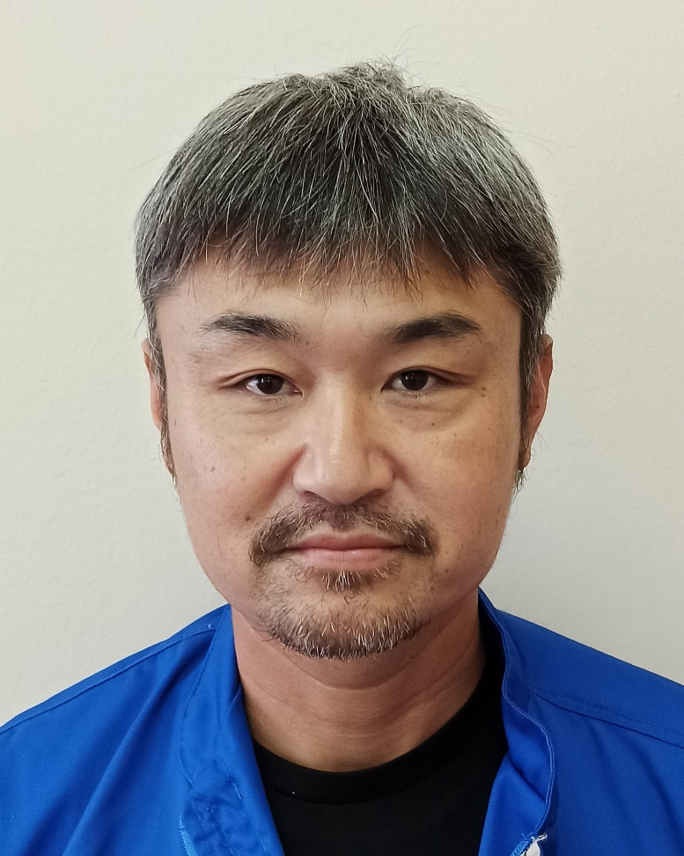
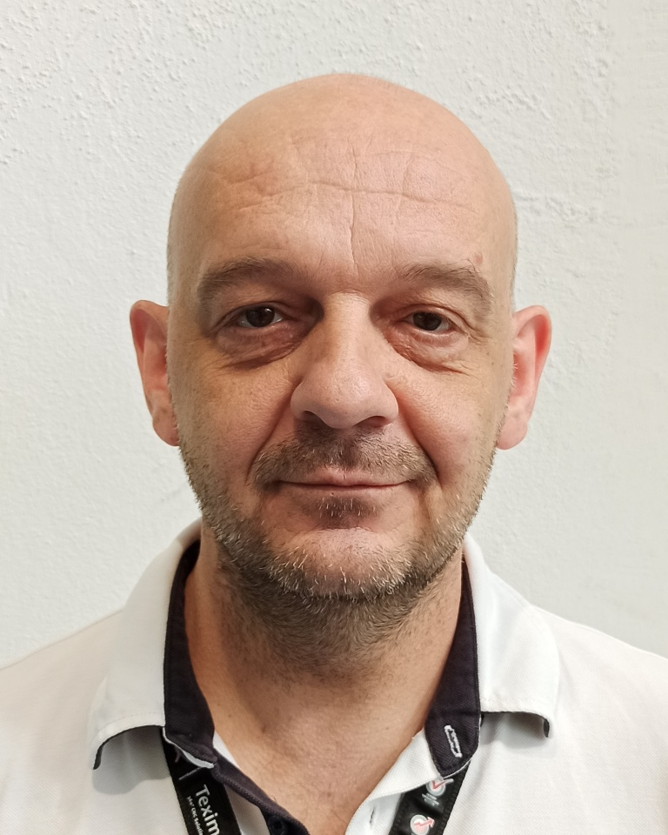
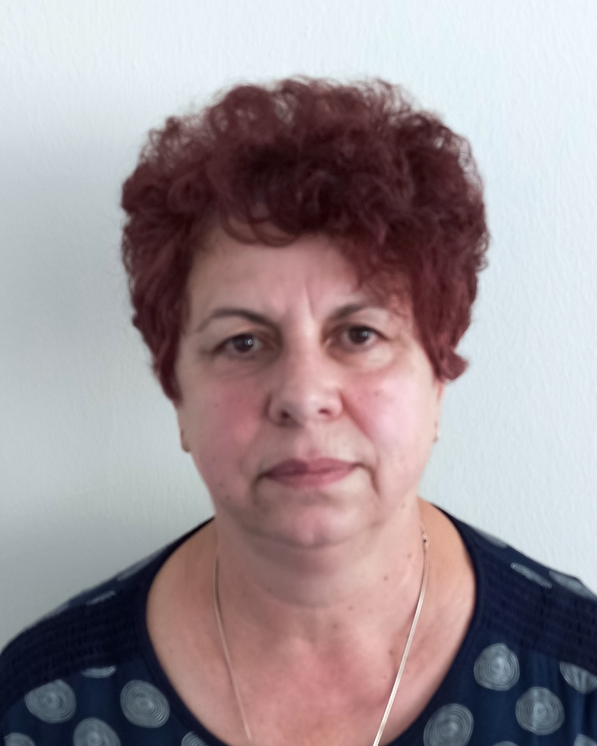
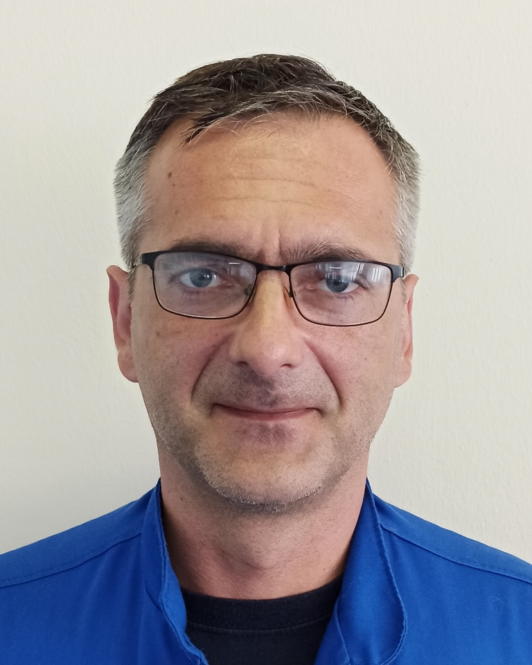
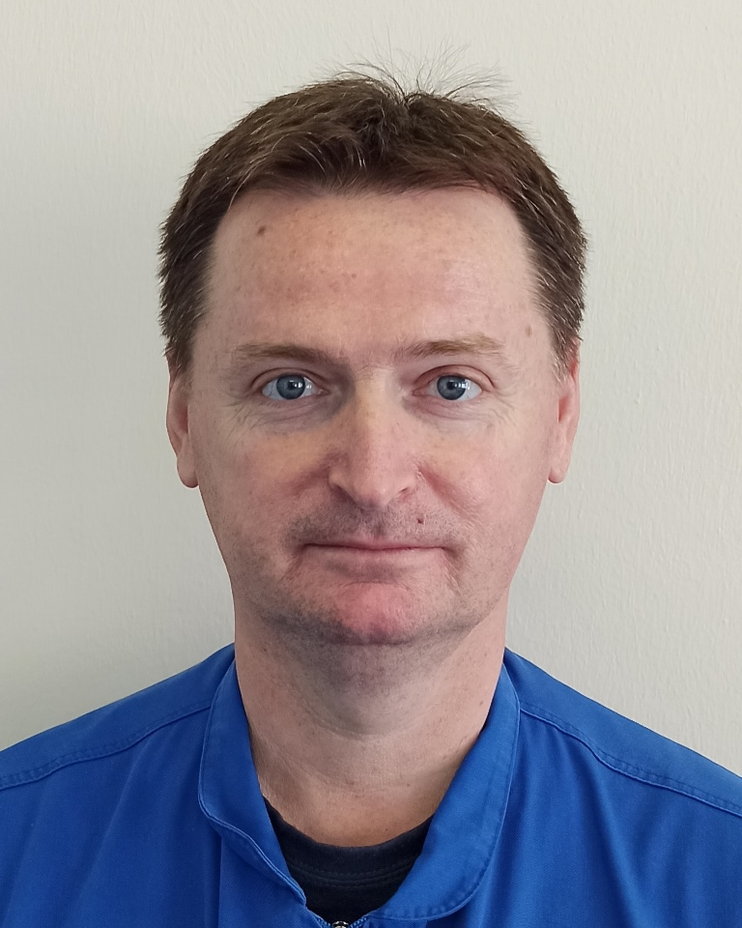
Our team
BOARD OF DIRECTORS
Shoda, Iwakura, Takagi
EXECUTIVE MANAGER
Yasunobu Nagi
TECHNICAL
ADVISOR
Fukutome Masahiro
DEPUTY EXECUTIVE MANAGER
Filip Mostrokol
QUALITY
Jelena
Vukomanovic
PRODUCTION
Gracija Radovic
TECHNOLOGY
Darko Skupnjak
LOGISTICS
Semira Seferovic
FINAL INSPECTION
Boris Koprivica
MAINTENANCE
Igor Djurisic
HUMAN RESOURCE
& FINANCE
Filip Mostrokol

Slide 9
Our plant and process
Products OUT
Waste water
treatment
Semi Finished Parts Storage /
Slitted Bimetal Strip Storage
Packing Material
Storage
Finished Parts
Warehouse
Slitter
TW
Y
01
Y
03
AM
Ink Jet
&
VCM
Final
Inspection
Incoming
Warehouse
Bimetal Strip
Storage
D/F
Assy
and Packing
MCF
Tool shop,
Maintenance
Compressors
+ Welding
Notch
Wash
M/C
NC
area
Y07
Material IN
YP-04
Y06
YP-03
Y05
YP-01
Y04
Tool
Storage
YP-02
Y02
Machining area
40 m X 45 m
Gauge room

Slide 10
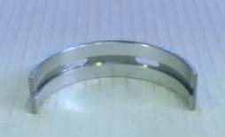
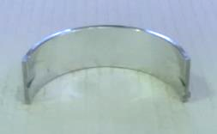
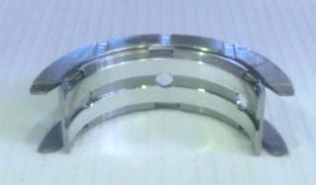
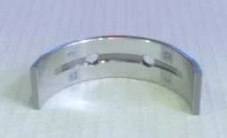
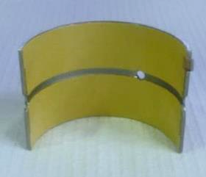
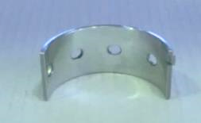
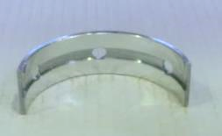
Our products

Slide 11
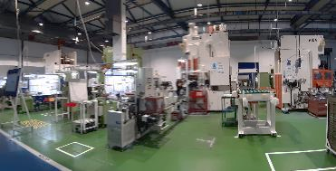
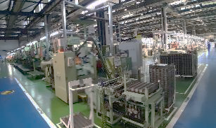
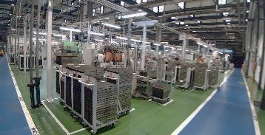
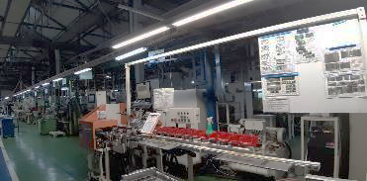
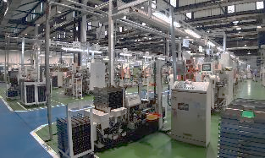
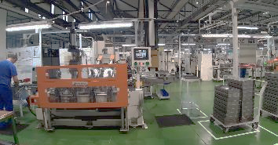
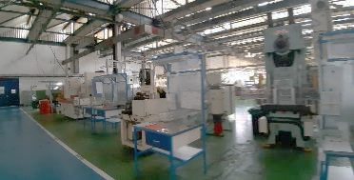
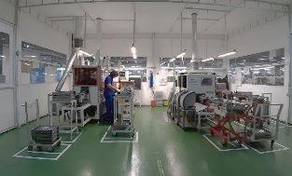
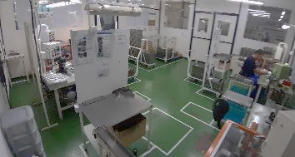
Our equipment 1/2
Press m/c
Y01 m/c line
Y02 & Y04 m/c line
Y03 m/c line
Y05, Y06, Y07 m/c line
Notch press
TW area
Ink jet
DF Assembling

Slide 12
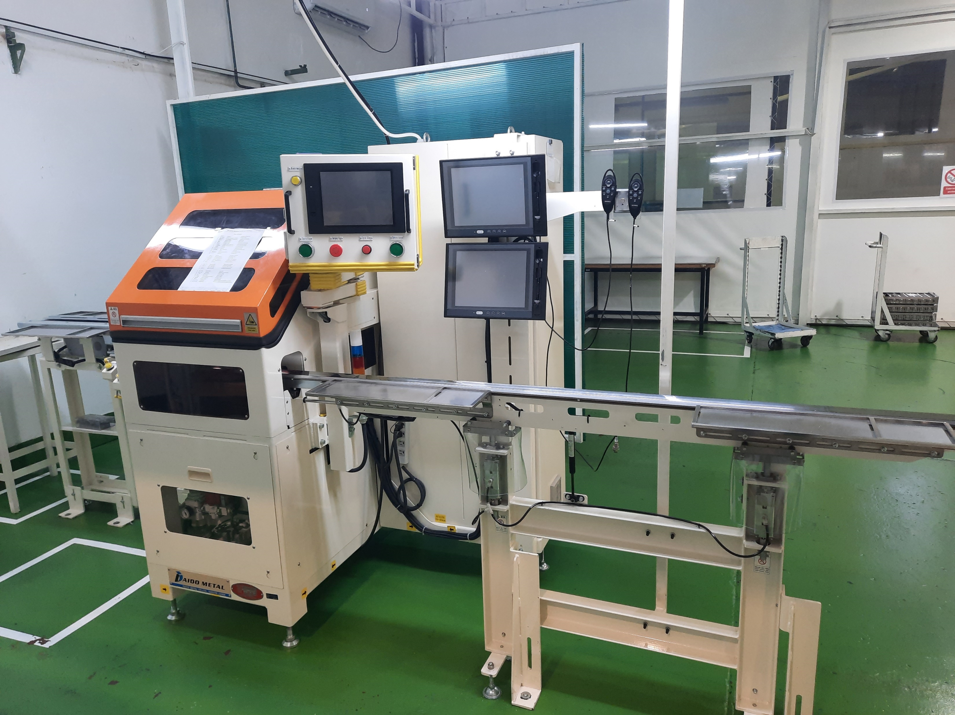
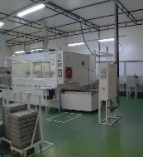
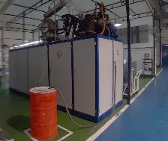
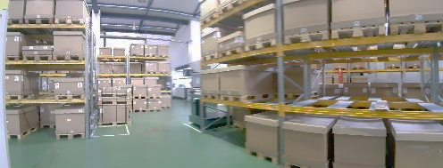
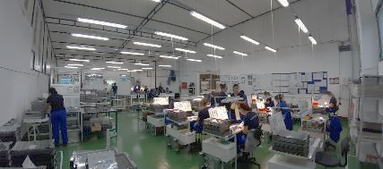
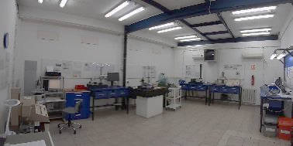
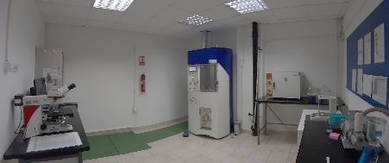
Our equipment 2/2
Washing m/c Cleanvy & Durr
Visual Check Machine
Final inspection and packing
Finished goods warehouse
Gauge room
Cleanliness laboratory

Slide 13
Our customers

Slide 14
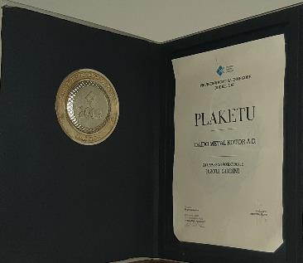
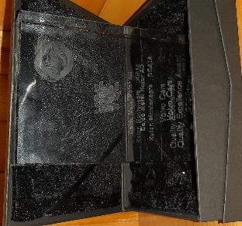
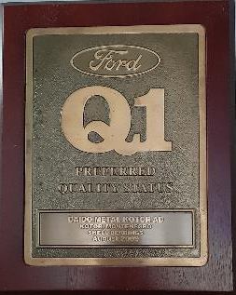
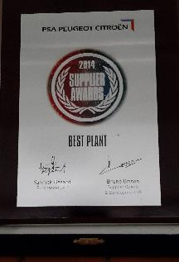
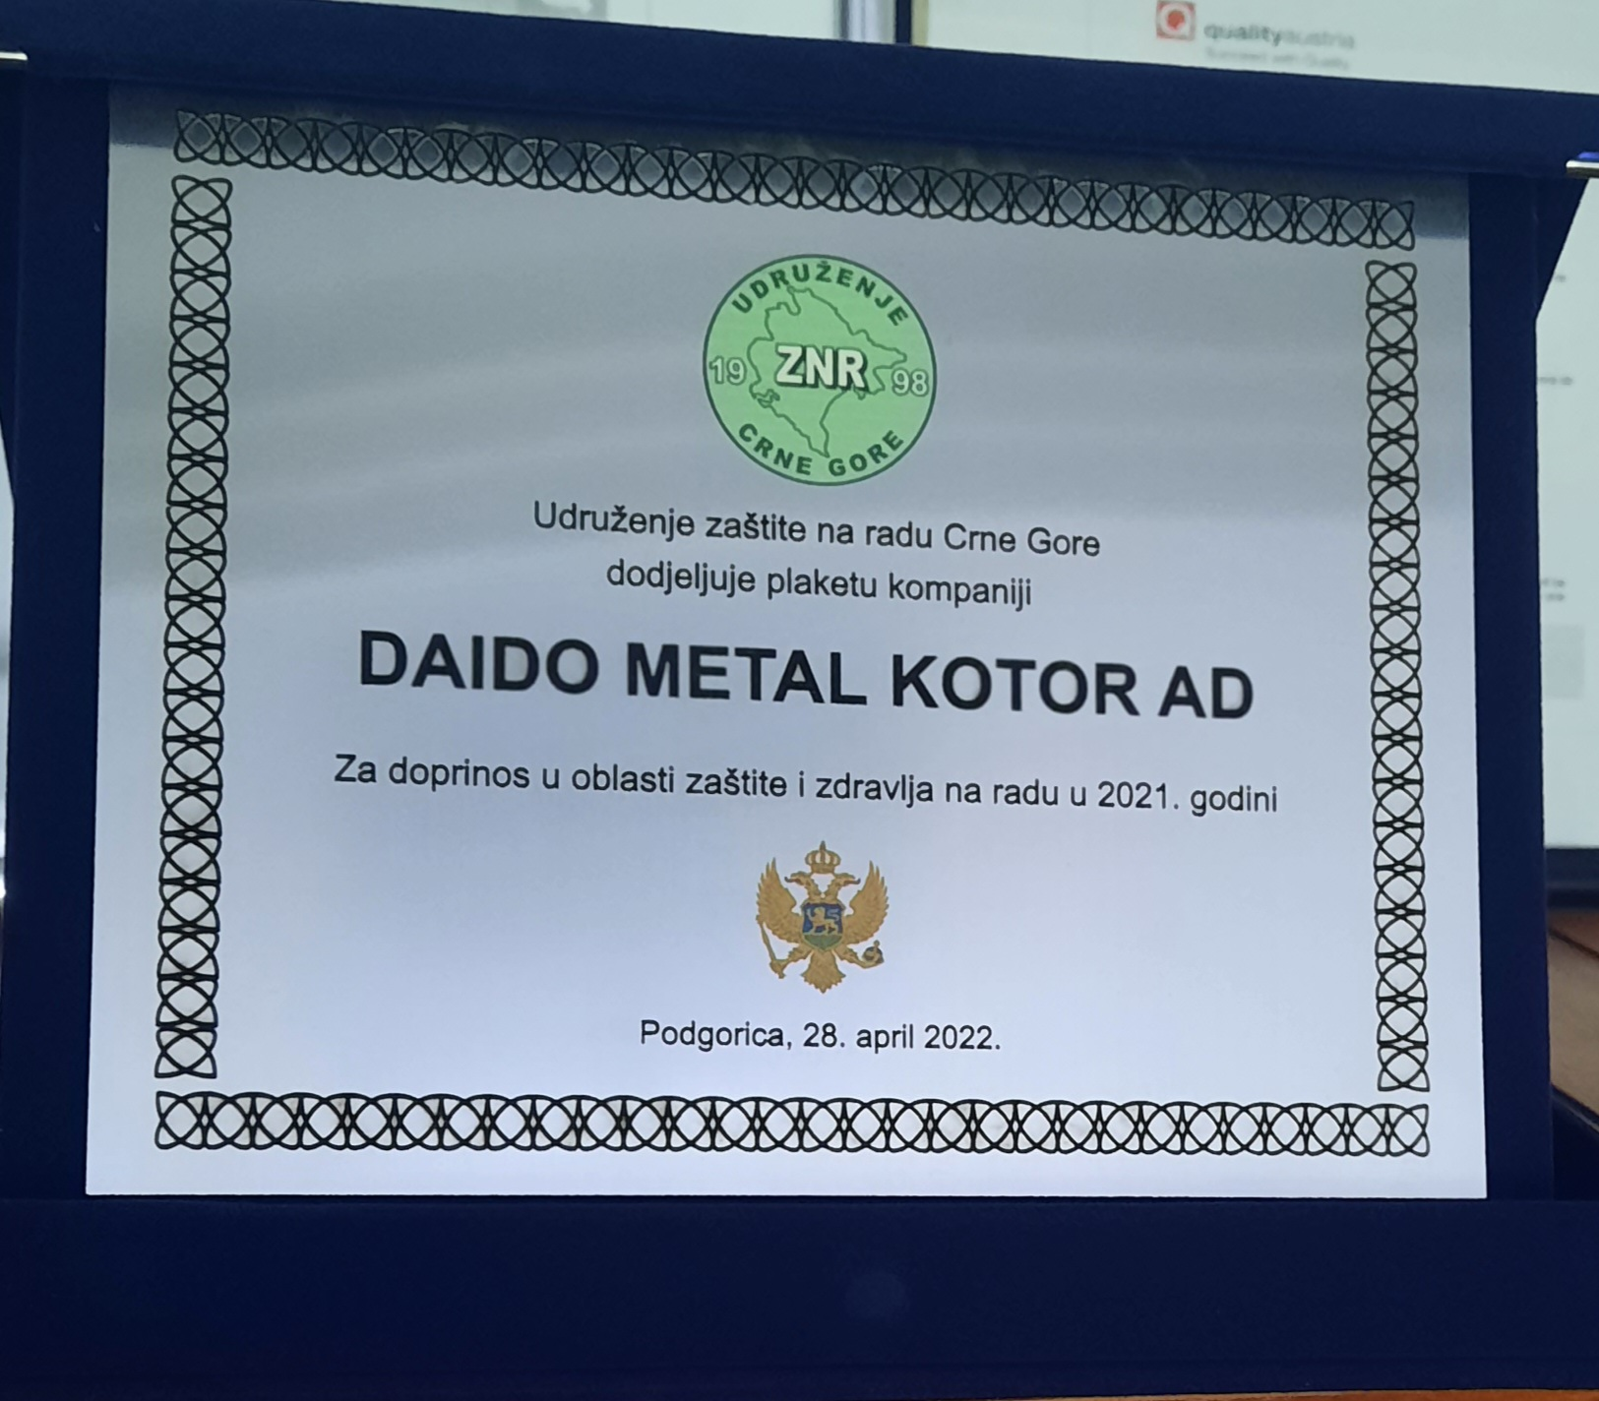
Certificates & Awards 1/2
2009 - Ford
Q1 Preferred Quality Status
2012 – Montenegro Government,
Chamber of Commerce Successful Business Award
2013 – Volvo
Quality of Excellence Award
2014 – PSA Peugeot Citroen Supplier Awards
2022 – MNE Safety at work Association
Safety at Work Contribution

Slide 15
Certificates & Awards 2/2
Certified since 2018*
(before ISO/TS 1649 since 2004)
Certified since 2003
Certified since 2004

Slide 16
Future plans

Slide 17
Thank you

