Slide 1



acserbia.org.rs

Slide 2

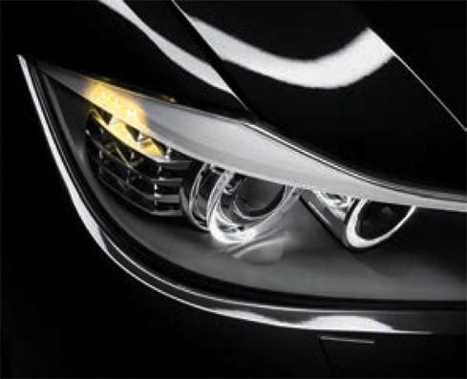
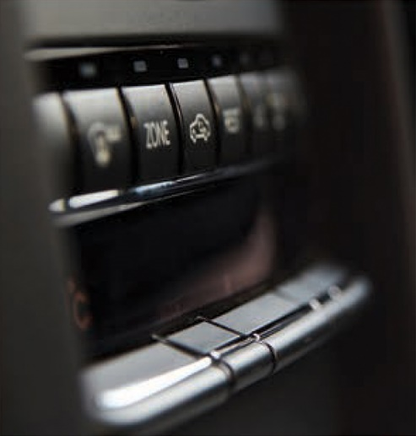
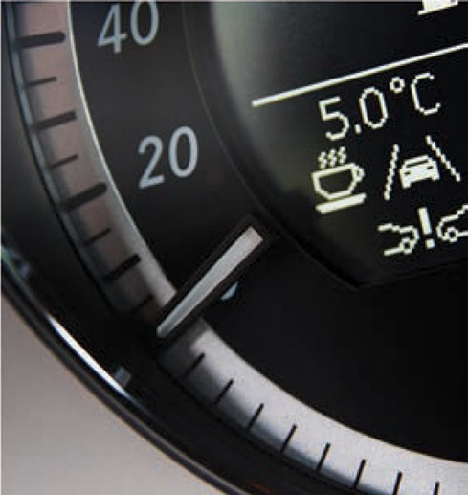
acserbia.org.rs
  Serbian Automotive Cluster – AC Serbia is a network of Serbian companies and institutions that are producing automotive parts and components.
AC Serbia was founded in Nov. 2010
(10 members)
Actually 54 members (January 2023)
  51 companies
  2022 (14.000 employees, EUR cca 2 Bl. turnover )
  3 R&D Institutes

Slide 3
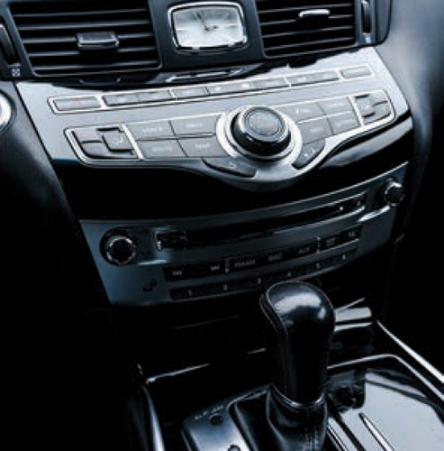
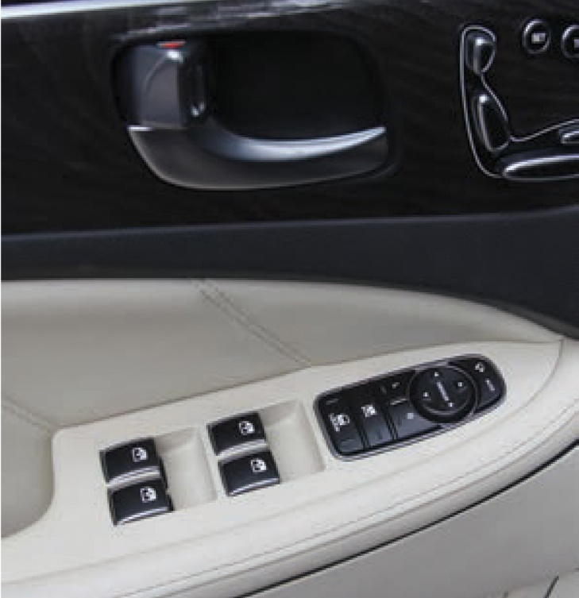
acserbia.org.rs
  Support and partner institutions
  Serbian Ministry of Economy
  Development Agency of Serbia - RAS
  PKS – Serbian Chamber of Commerce
  GIZ - German Organization for International Cooperation
  UNIDO - United Nations Industrial Development Organization
  USAID
  Vojvodina Investment Promotion Fund – VIP
  OECD

Slide 4
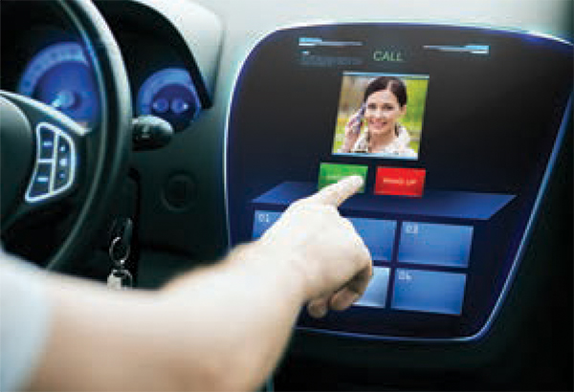
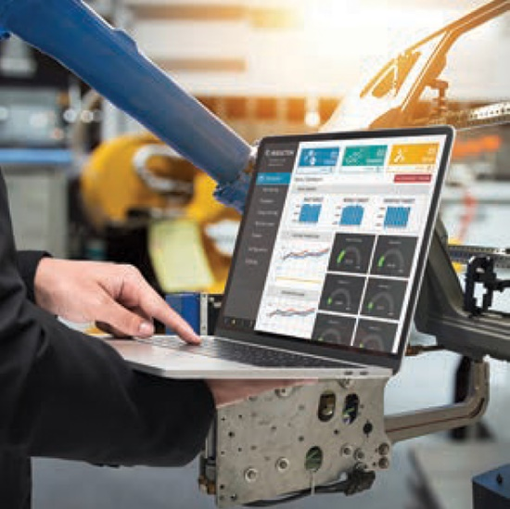
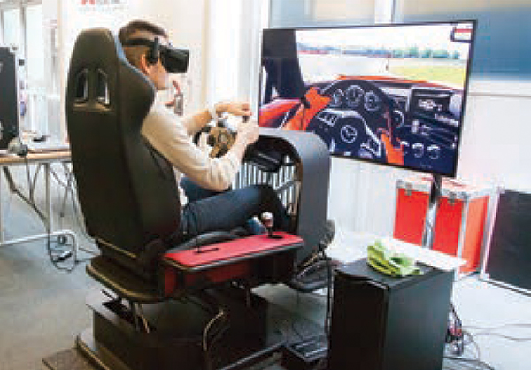
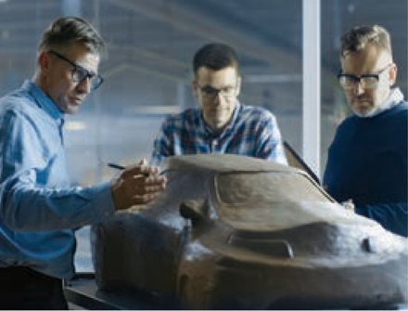
acserbia.org.rs
Main Goals
Extending connections between Serbian and European automotive industry
Increase the competitiveness of our members
Support to our companies to be part of international supply chains of European car producers
Improve the economic situation within the whole automotive supplier sector in Serbia

Slide 5
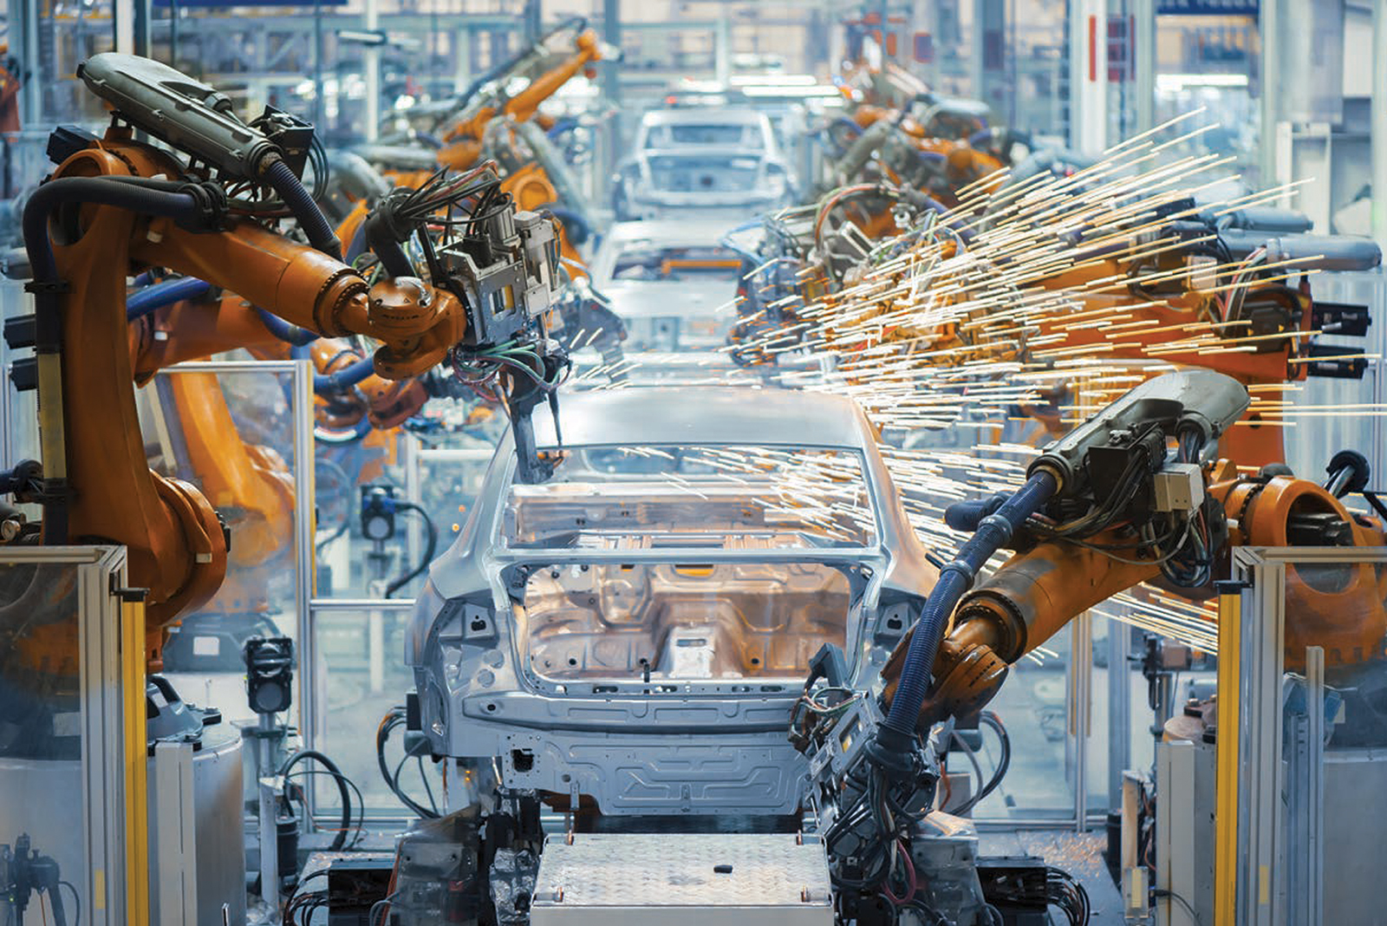
acserbia.org.rs
Business Development Support
CLUSTER SERVICE SYSTEM
MARKETING
EXPORT SUPPORT
EDUCATION / CONSULTING
RESEARCH AND DEVELOPMENT
COMMUNICATION
AND COOPERATION
QUALITY MANAGEMENT
CERTIFICATION
DIGITALIZATION / INDUSTRY 4.0
GREEN TRANSITION/SUST.
Through its service system the AC Serbia office holds
the function of a ONE STOP SHOP!
All services/ information available IN ONE PLACE!
Cluster members / clients
SAVE TIME AND EXPENSES!

Slide 6
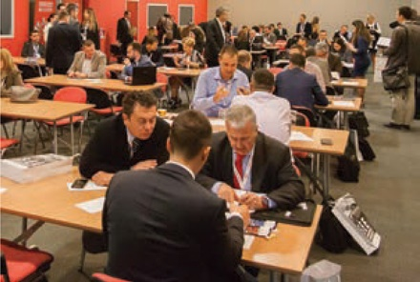
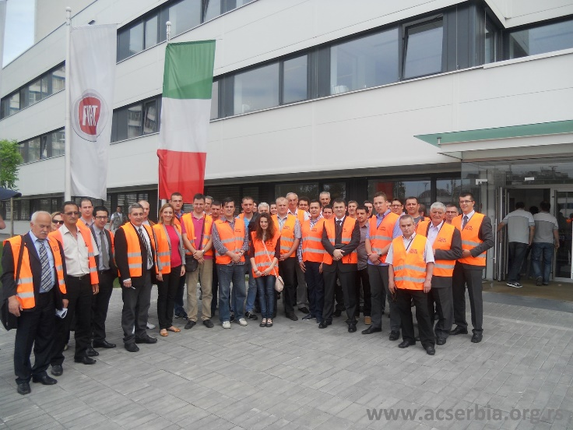
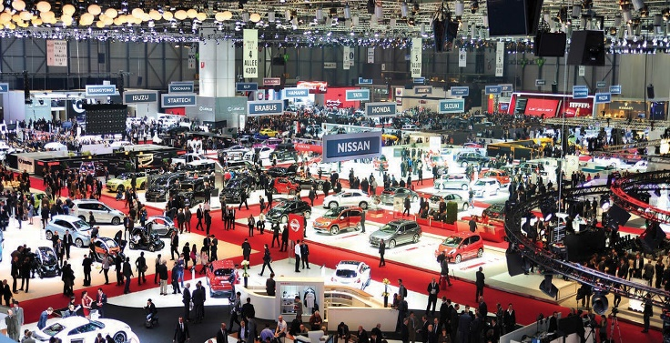
acserbia.org.rs
Marketing & Export Promotion
International trade fairs and conferences
Delegation trips (Visits to OEM and biggest TIER1 suppliers)
B2B matchmaking events
Event organization: Conferences/Meetings
Market research
Company Profiles/Database
Info materials: Catalogues and Brochures
Presentations to potential buyers

Slide 7
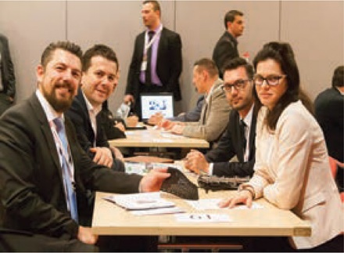
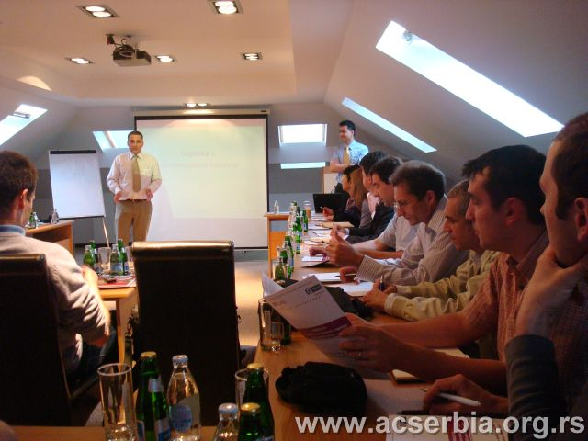
acserbia.org.rs
Education & Consulting
Lean Management
Seminars, workshops, trainings and shop-floor interventions
Innovation
Development of new products and prototypes
Product design
Energy efficiency
Coaching and individual consulting
Green transformation
Coaching and individual consulting, common cluster activities
Other BDS areas:
IT technology, Marketing/Promotion, Strategic planning
Business strategy development, Market research, CSR etc.

Slide 8
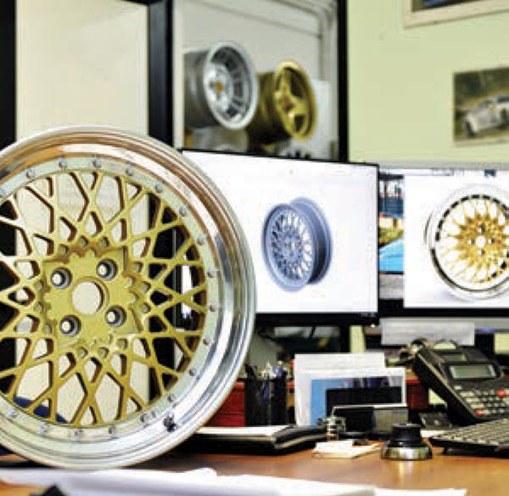
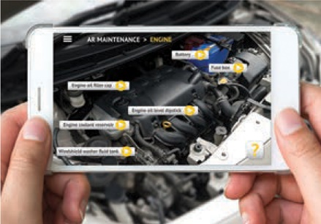
acserbia.org.rs
Research & Development
Project Cooperation
Joint participation in development projects:
National calls, International and EU projects
Applied Research and Development
Faculties and institutes upon request of single or united companies
Testing Infrastructure
Testing laboratories: easier access for AC Serbia members
Student internships
in cooperation with Faculties

Slide 9


acserbia.org.rs
Communication and Cooperation
Meetings/events
Encouraging cooperation between members
Working groups
PROJECTS - Participation in national and international projects
Participation in international conferences

Slide 10
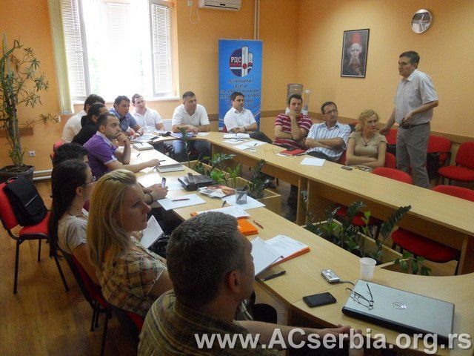
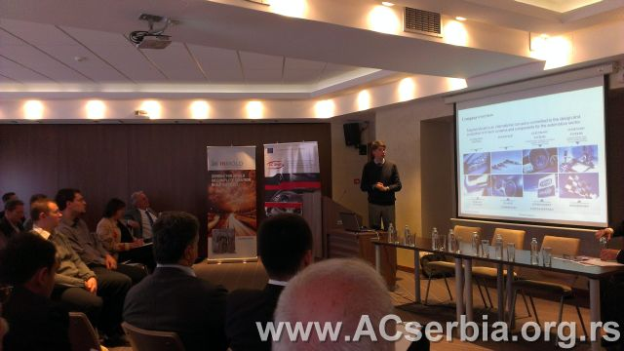
acserbia.org.rs
Quality Management Certification
SCHOOL OF QUALITY
Seminars
Training for internal auditors
ISO 9001
IATF 16949
ISO 14001
ISO 26000
VDA 6.3
ISO 27001 and TISAX
Sustainability

Slide 11
acserbia.org.rs
Digitalization / Industry 4.0
Robotics
Process engineer school
Digitalization of supply chains
Digitalization strategy in auto-industry
Academy for digitalization in cooperation with Centar for Digital Transformation

Slide 12
acserbia.org.rs
Green Transformation - Companies Sustainability
Legal regulations and requirements (EU/Serbian)
OEM requirements towards their suppliers
Customer requirements
Awareness campaign for companies
Input for the review and implementation of the Serbian Industrial Policy
Study on the current status in Serbian automotive companies and lobbying for public support measures

Slide 13
acserbia.org.rs
THANK YOU FOR YOUR ATTENTION!
AC Serbia
11000 Belgrade, Serbia
Tel. +38162400086
E-mail: igorvijatov@acserbia.org.rs
Web: www.acserbia.org.rs
www.seeautomotive.com

