Slide 1
Best of the digital Services of the Federal Austrian Economic Chamber
EU – WB6
DIGITAL SERVICES ACADEMY
Digital Summit, Pristina
September 20th -23rd 2022
Gerhard Laga Servicemanagement and ICT of the Federal Austrian Economic Chamber

Slide 2
Overview
Services based on our member register
WKO-Singlelogin
Data-Certification in the Austrian Public Service Blockchain
Online Contents
Online Consulting Services
Webinars and Screencasts
Modelcontracts with possibility to infill
KMU.DIGITAL financial support program: Speciality consultation reports in structured form
Vision wko.at#23

Slide 3
Services based on our member register „Firmen A-Z“
587.399 companies, some data ist fixed and official, most are editable by members only
Members get found and can further present their company (Logos, Videos, structured Information about the company for other portals) 3.5 mio hits per month
Free imprint-generator
Free advertisements for
Cooperations (automatically updated)
Successions
can be shared in social media
„certificates“ and productes used for structured searches
tailor made searches eg for communes

Slide 4
WKO-Singlelogin
Federated Identity Management – who knows, what this is?
But for companies, not only persons
Is already in use by some portals
Usecases:
B2B marketplaces,
extranet for big companies,
„hardened“ identity for data services
Technical specification widespread in Austria because of public sector
Rulebook as a legal basis, working-party behind

Slide 5
Data-Certification in the Austrian Public Service Blockchain
Blockchain notarization service for all (wko.at user necessary)
Copyright protection and proove
business correspondence
production process
GDPRcompliant Blockchain behind it (Multichain 2.x based)
Open Source, no energy waste
Data stays with user, just a fingerprint is saved
creation AND verification is free

Slide 6
Online Contents – Webinars and Modelcontracts
Webinars and Screencasts are natural since COVID, we offer 3-4 each day!
flexibility for organizers and targetgroups first
Not all of them beeing recorded
Modelcontracts, specific information in 3 areas
Labourlaw, HR
Taxes
Business Law
with hundred of documents, some with possibility to infill

Slide 7
Online Contents - Online Consulting Services
Special CMS allows automated guided multimedia dialog with users
Nearly 50 dialogs available
labour law
education
digitalisation, e-invoicing, e-government
taxes
environment
funding, new: covid funding
business law
~80.000 finished dialogs each month!
24/7 results, equal quality of content, can be used as a blueprint in the work of regional chambers
multilingual, very important in some branches eg caretakers
Can also be used in other situations, see KMU.DIGITAL

Slide 8
KMU.DIGITAL (SME.DIGITAL) - Funding Programm
An initiative from the Austrian Federal Ministry for Digital and Economic Affairs and Federal Austrian Economic Chamber.
Nearly 800 trained and certified consultants offer advise in 4 topics and develop digitalisation plans together with SME.
This consultancy is mainly financed by the government. The consultants deliver structured reports to give an insight in digital trends in Austria.
The implementation of the plans is also partly funded.
Quick and efficient online application and settlement.
2017-2022: ~20.000 consultant talks (!) and ~800 implementations supported
Speciality: Gaining knowledge about the digital status of our members!
all consultation reports are done in structured form
every consultancy has to point out at least one out of 50 specific trends
each trend

Slide 9
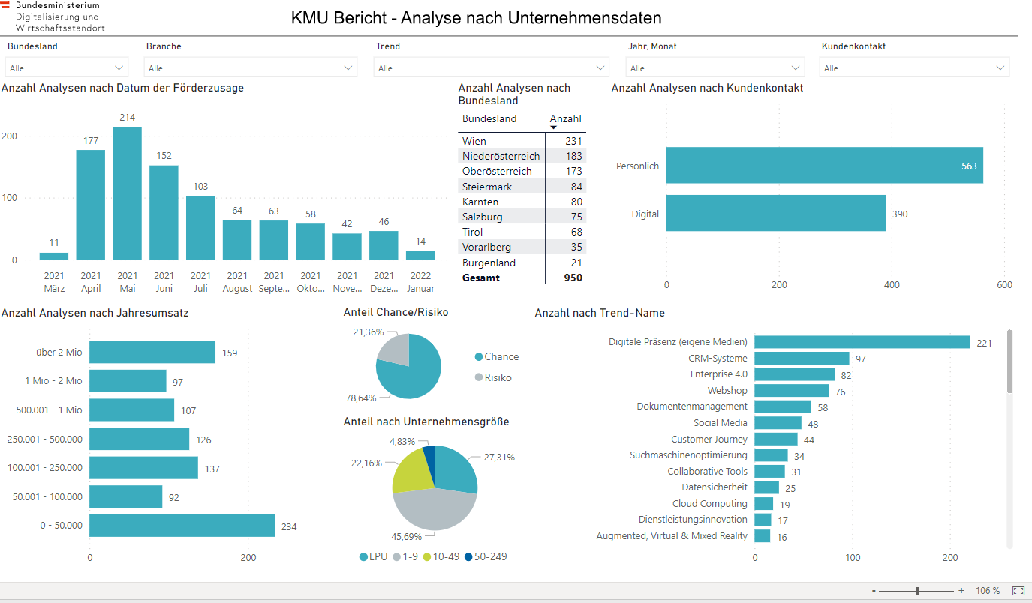

Slide 10
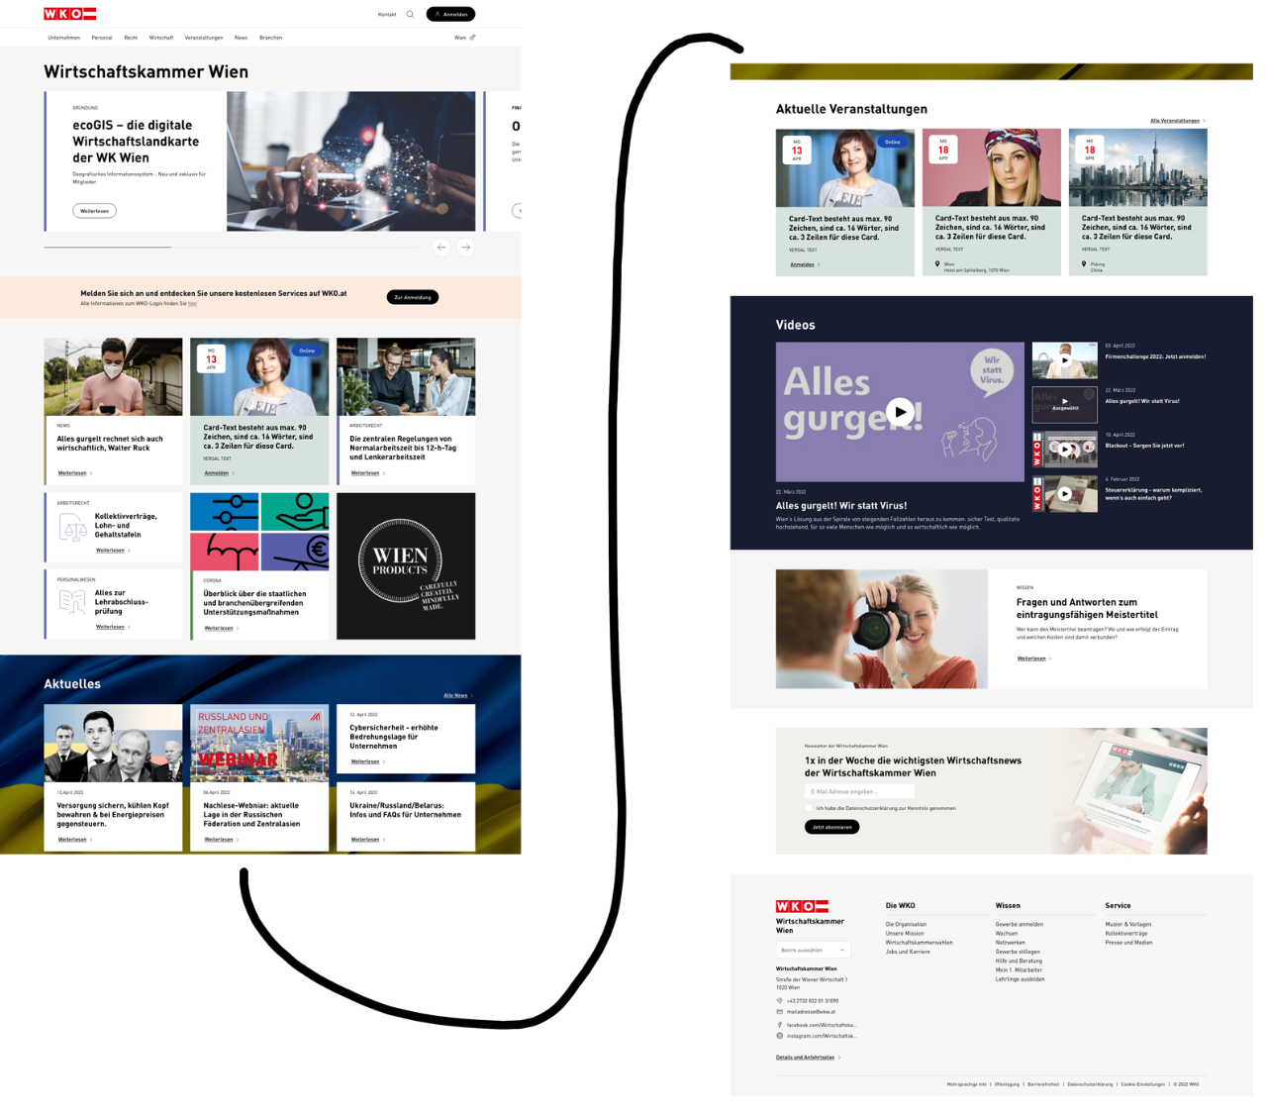
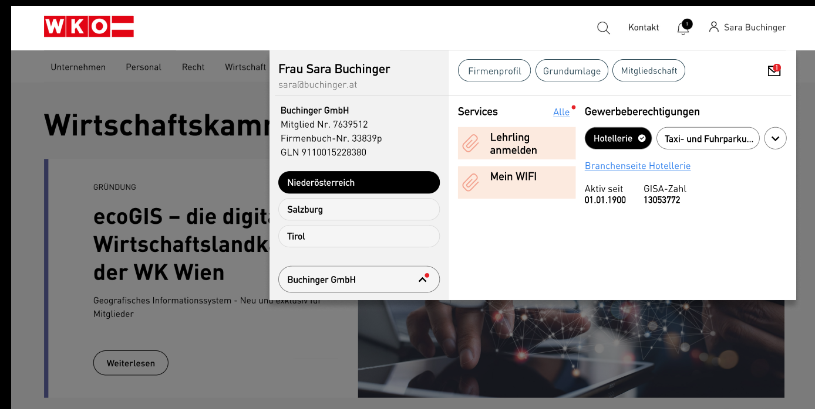
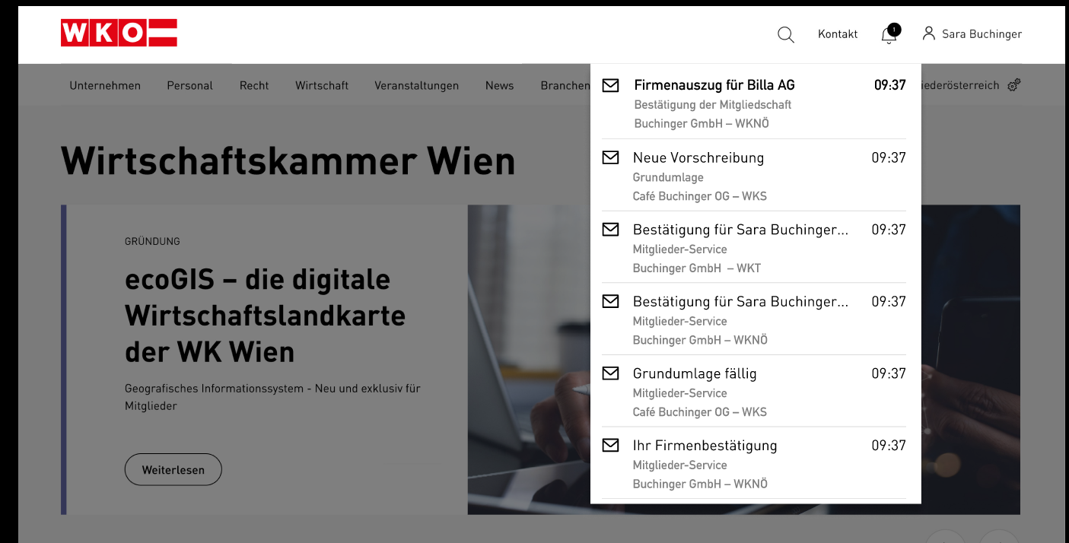
Vision wko.at#23 – contemporary online strategy
personalized
modern look
Q4/21 until Q1/23
internal communication ongoing

Slide 11
internal CRM- WKBlue
all member oriented business processes digital and on one plattform
all data stored in one place -> no Excel, no Emails
based on the cooperation of regional chambers
from calls, emails to personal visits, events and internation missions
technical basis for funding programms

Slide 12
Thank you for your attention!
Questions please!
Would be happy to discuss any aspects during the next 2 days!
Contact: gerhard.laga@wko.at, +435909004203

