Slide 1
Modern Enterprises’ Programme
Peter Koleszar, Head of Section of Digital Education of Hungarian Chamber of Commerce and Industry

Slide 2
THE USe OF ERP SOLUTIONS IN THE sme SECTOR (2015)
Source: Digital Agenda Scoreboard http://digital-agenda-data.eu
Notes:
ERP – EU average: 34,3% - HU: 14,5% - almost 20% lower than the EU average and more than 40% lower than the leading Germany.
According to our 5000+ research, about 31% of the SMEs are willing to use ERP software programs as a result of our program.
CRM (Customer relation management): EU: 20,2%, HU: 8,7%
How is it possible? What are the reasons for our technological backwardness and what are our obstacles?
The causes of the lack of leadership and ownership objective (demotivation)
insufficient or misleading information about digital technologies
Frustration due to the lack of personal IT skills
Fear of transparency, data security, privacy concerns
Financing difficulties, lack of resources

Slide 3
2015 Hungarian SMEs didn’t use or they didn’t use on an acceptable level
the digital technologies .
Disadvantage
Notes:
ERP – EU average: 34,3% - HU: 14,5% - almost 20% lower than the EU average and more than 40% lower than the leading Germany.
CRM (Customer relation management): EU: 20,2%, HU: 8,7%
How is it possible? What are the reasons for our technological backwardness and what are our obstacles?
The causes of the lack of leadership and ownership objective (demotivation)
insufficient or misleading information about digital technologies
Frustration due to the lack of personal IT skills
Fear of transparency, data security, privacy concerns
Financing difficulties, lack of resources

Slide 4
CAUSES
Fear of transparency, data security,
privacy concerns
Insufficient or misleading information about
digital technologies
Frustration due to the
lack of personal IT skills
Financial difficulties,
lack of resources
Notes:
How is it possible? What are the reasons for our technological backwardness and what are our obstacles?
The causes of the lack of leadership and ownership objective (demotivation)
Fear of transparency, data security, privacy concerns
insufficient or misleading information about digital technologies
Frustration due to the lack of personal IT skills
Financing difficulties, lack of resources

Slide 5
What was our solution?
An ICT related motivational, awareness raising and competence development program for the SMEs

Slide 6
MODERN ENTERPRISES’ PROGRAMME
Started in 2015.
Plan: project will run for 2 years (still running)
5 million Euro (for 2 years)
16 million Euro (8 years)
Runs by EU development funds
Free of charge (all services)

Slide 7
Notes:
In this slide you can see the brand vision of the project. This is a finger which pushes a button which writen on the following text: Do you enter.

Slide 8
Notes:
Our program, the Modern Enterprises’ Programme is operated by the Hungarian Chamber of Commerce and Industry.
We launched the a program at the end of 2015 and the 1st phase was finished by the end of July, 2017.
The 2nd phese of the program started in August and running for 2 years.

Slide 9
Pillars of the project
Product database
Knowledge base
Consultation
Events
Notes:
We run a nation-wide ICT consultant network with 26 ICT consultants.
They provide ICT audits for the businesses
They help work out their ICT development strategies and action plans, they help create a concept, a vision for the to SMEs
They make suggestions on possible developments and the introduction of ICT services
We support the with information information on available funding sources

Slide 10
Service pillar I. FREE ICT AUDITS AND CONSULTING
Nation-wide ICT consultant network
ICT audits, ICT strategies and action plans
Notes:
We run a nation-wide ICT consultant network with 26 ICT consultants.
They provide ICT audits for the businesses
They help work out their ICT development strategies and action plans, they help create a concept, a vision for the to SMEs
They make suggestions on possible developments and the introduction of ICT services
We support the with information information on available funding sources

Slide 11
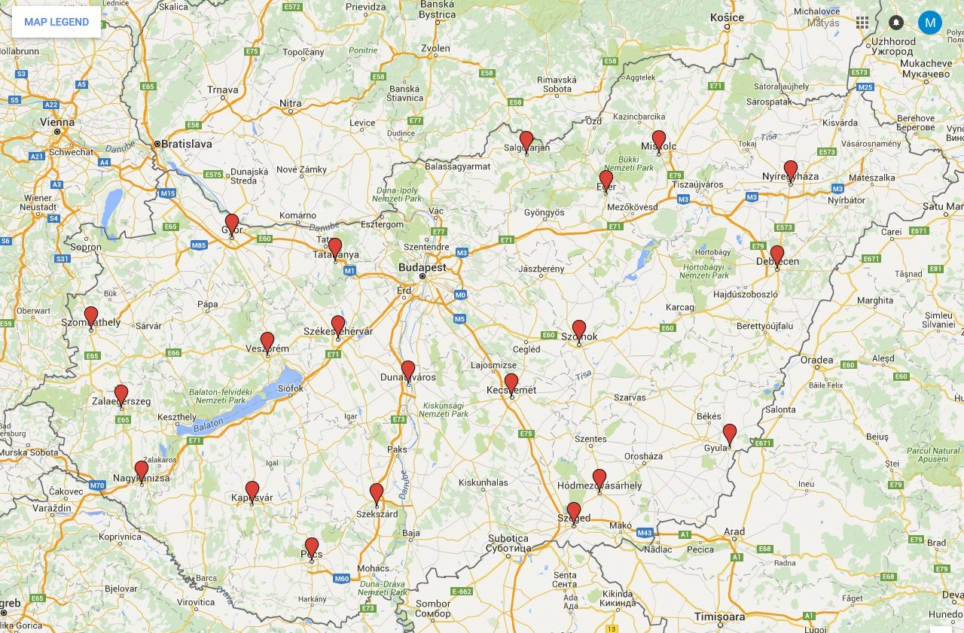
CONSULTANTS’ NETWORK
Notes:
In the first period we had 27. experts, now we have 18.

Slide 12
Service pillar II. QUALIFIED SUPPLIERS, PRODUCTS AND SERVICES DATABASE
Discounted products and services for the enterprises by qualified providers.

Slide 13
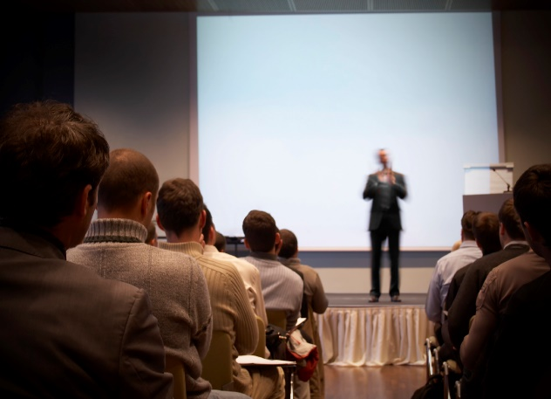
Series of 300 events nation-wide
III. Pillar - Events
Useful lectures, consultations
Contact with suppliers and exhibitors
Consultation with a regional ICT consultant
Professional sections and forum discussions, Q&A sessions

Slide 14
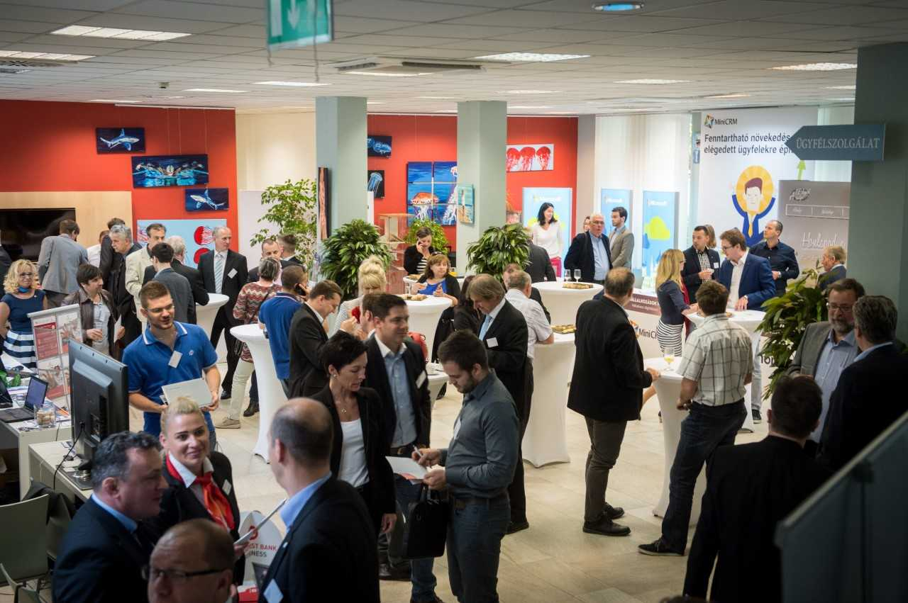
”Marketplace” of a Digital day

Slide 15
Free access to our searchable knowledge base
IV. Pillar – Knowledge base
Educational radio talks
Podcasts
Q&A
Different styled video contents

Slide 16
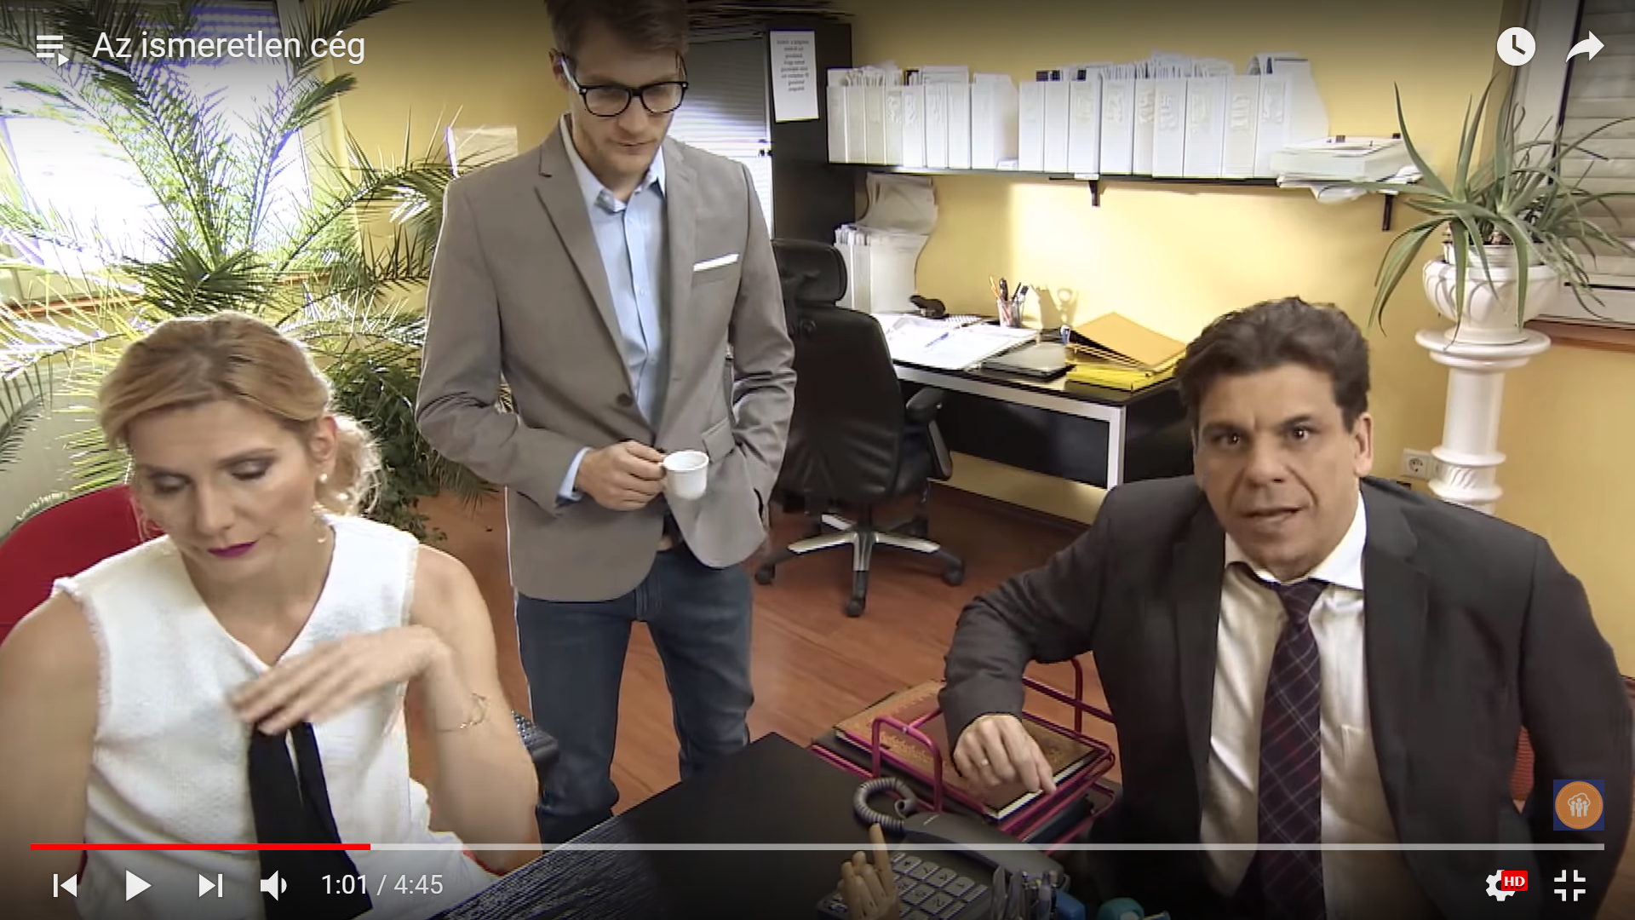
SITCOM Stories

Slide 17
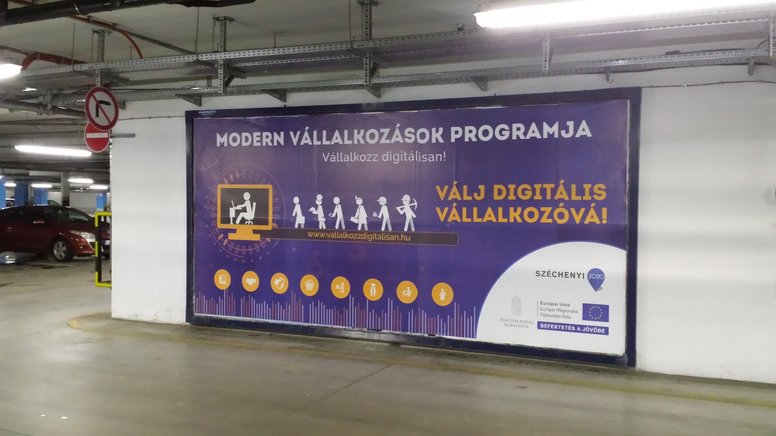
BILLBOARD CAMPAIGN

Slide 18
Our results
READY-MADE ICT CONCEPTS
DISCOUNTED ICT SOLUTIONS
14 000+
3 100+
COMPANIES JOINED
ICT MODULES USED BY COMPANIES
23 000+
40 000+
QUALIFIED ICT PROVIDERS
EVENTS
1 000+
300+

Slide 19
Thank you for your attention!
Our website:
www.VallalkozzDigitalisan.hu

